Slide 1
Estimating Populations of
Men Who Have Sex with Men in the United States
Northeastern Region
Based on the 2009-2013 American Community Survey

Slide 2

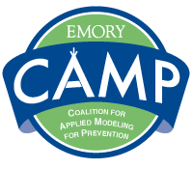

NCHHSTP Epidemiologic and Economic Modeling Agreement (NEEMA)
NEEMA is a 5-year cooperative agreement funded by CDC/NCHHSTP to further modeling efforts in five areas:
NEEMA’s purpose is to create and adapt models to support public health decision-making and effectiveness at national, state and local levels.
HIV Tuberculosis Sexually Transmitted Diseases | Viral Hepatitis School/Adolescent Health
This work was supported by the CDC/NCHHSTP Epidemiologic and Economic Modeling Agreement (5U38PS004646). The findings and conclusions are solely the responsibility of the authors and do not necessarily represent the official views of the Centers for Disease Control and Prevention or the Department of Health and Human Services.
Notes:
Estimates of the population sizes of men who have sex with men in the United States is a product of the Emory Coalition for Applied Modeling for Prevention, or CAMP. CAMP is funded by a grant from the National Center for HIV/AIDS, Viral Hepatitis, STD, and TB Prevention: the NCHHSTP Epidemiologic and Economic Modeling Agreement, or NEEMA.
NEEMA is a 5-year cooperative agreement to collaborate with CDC scientists on modeling efforts related to HIV, tuberculosis, sexually transmitted diseases, viral hepatitis, and school and adolescent health.
The goal of NEEMA is to create models with practical significant to public health efforts at national, state, and local levels.

Slide 3
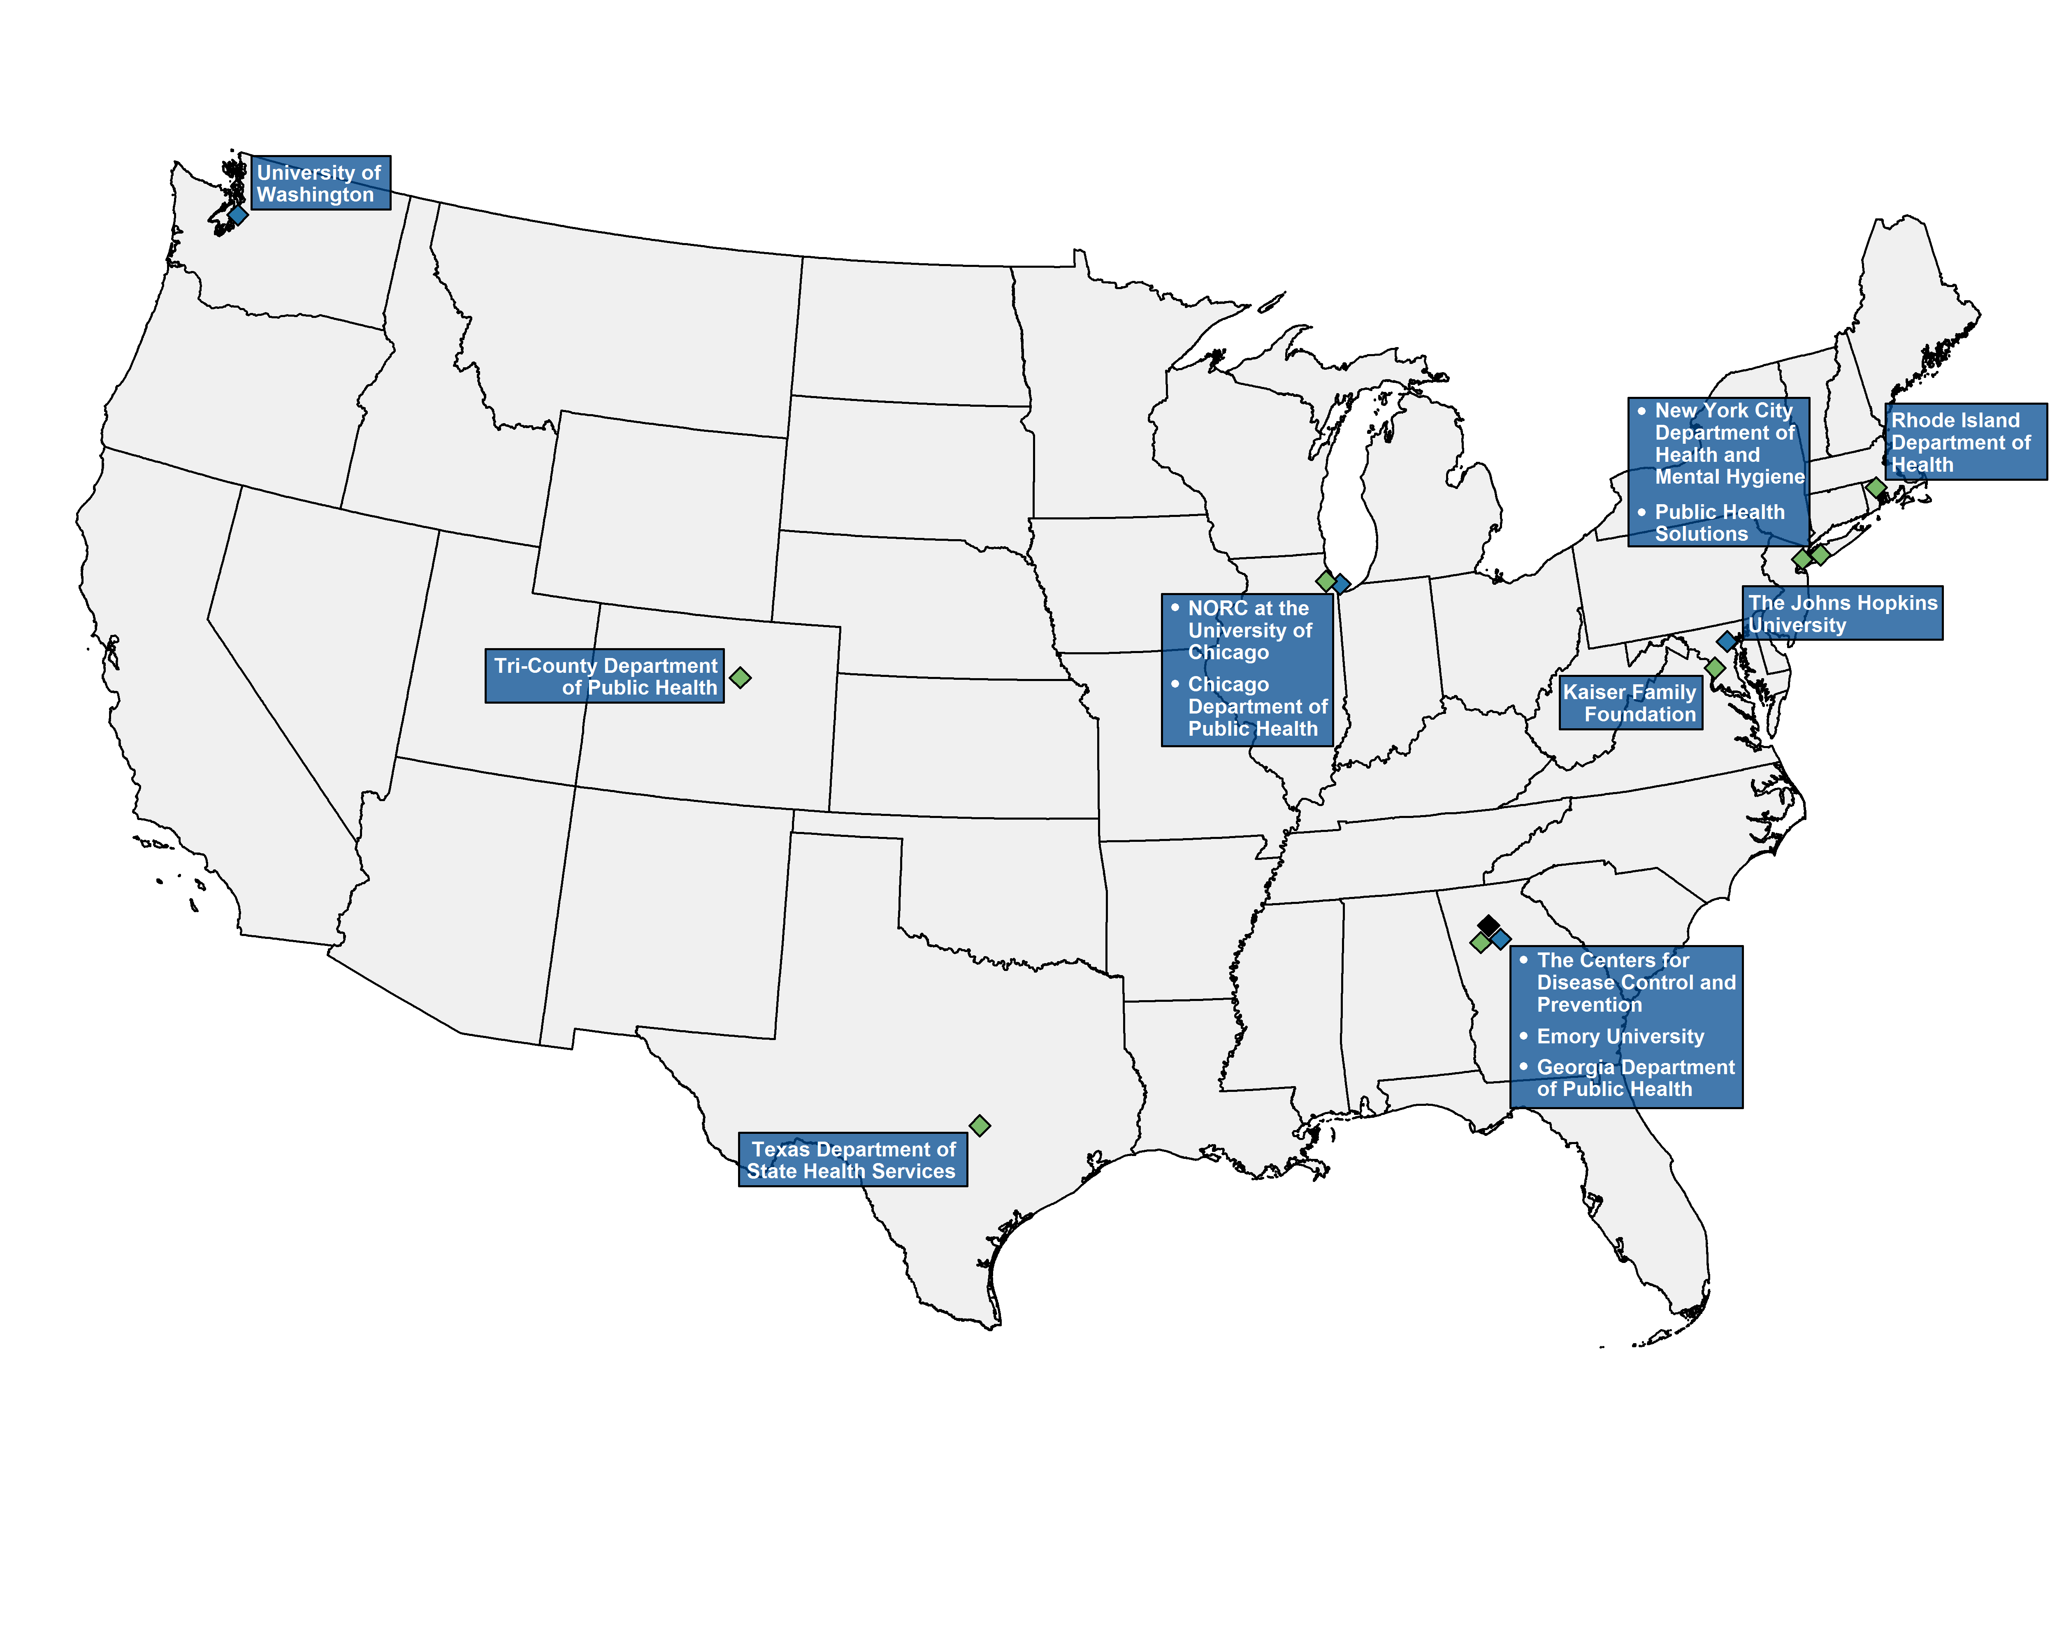
Emory Coalition for Applied Modeling for Prevention (CAMP)
The Emory Coalition for Applied Modeling for Prevention (CAMP) is the Emory University-coordinated workgroup funded by NEEMA.
CAMP was developed as a collaboration between CDC scientists, academic researchers, and public health providers from institutions across the United States to create, refine, and disseminate models to improve public health practice.
CAMP Government, Academic, & Applied Public Health Partners
Notes:
The estimates in these slides and the associated manuscript were created as part of the Emory Coalition for Applied Modeling for Prevention, or CAMP. CAMP was funded by NEEMA, and is coordinated by staff at Emory University.
CAMP is a partnership between CDC scientists and academic researchers at Emory University, The Johns Hopkins University, University of Washington, and NORC at the University of Chicago. In addition, models that are developed by the CDC and CAMP are sent to individuals at health departments and health-related institutions across the United States for feedback and advice on dissemination.
Through this collaboration, Emory CAMP ensures that the final modeling products are useful to public health practitioners.

Slide 4
Methods Overview
The detailed methodology was published in 2016:
  Grey JA, Bernstein KT, Sullivan PS, Purcell DW, Chesson HW, Gift TL, Rosenberg ES. Estimating the population sizes of men who have sex with men in US states and counties using data from the American Community Survey. JMIR Public Health Surveill 2016;2(1):e14. DOI: 10.2196/publichealth.5365
The method uses data from 5-year ACS summary files:
  Number of adult males
  Number of households
  Number of male-male households (male householder and male partner)
  It also incorporates estimates from published analyses^{a,b}:
  Percentage of US men who have had sex with another man in the past 5 years (3.9%)ª
  Percentage of US men who have had sex with another man in the past year within four urban-rural categories^{b}
    Central counties of large metropolitan areas (4.4%)
    Fringe counties of large metropolitan areas (2.5%)
    Counties in medium or small metropolitan areas (1.4%)
    Counties that are not in metropolitan areas (1.1%)
ªPurcell DW, Johnson CH, Lansky A, Prejean J, Stein R, Denning P, Gau Z, Weinstock H, Su J, Crepaz N. Estimating the population size of men who have sex with men in the United States to obtain HIV and syphilis rates. Open AIDS 2012;6(Suppl 1):98-107.
^{b}Oster AM, Sternberg M, Lansky A, Broz D, Wejnert C, Paz-Bailey G. Population size estimates for men who have sex with men and persons who inject drugs. J Urban Health 2015;92(4):733-743.
Notes:
To estimate the number of men who have sex with men, we use several publicly available datasets and recent publications.
First, we use county-level data regarding the number of adult males, the total number of households, and the number of households with a male householder and male domestic partner.
Next, we incorporate estimates from peer-reviewed manuscripts for the prevalence of men who have sex with men among adult men in the United States. Because the definition of MSM can vary according to time frame, we use the meta-analytic estimate by Purcell and colleagues from 2012 that 3.9% of adult men in the United States have had sex with another man in the past five years. We also use estimates from Oster and colleagues’ 2015 paper to estimate the percentage of adult men who have had sex with another man in the past year and reside in central counties of large metropolitan areas, fringe counties of large metropolitan areas, counties in medium or small metropolitan areas, and counties that are not in metropolitan areas.
The full methodology was published in 2016 in the Journal of Medical Internet Research, Public Health and Surveillance.

Slide 5
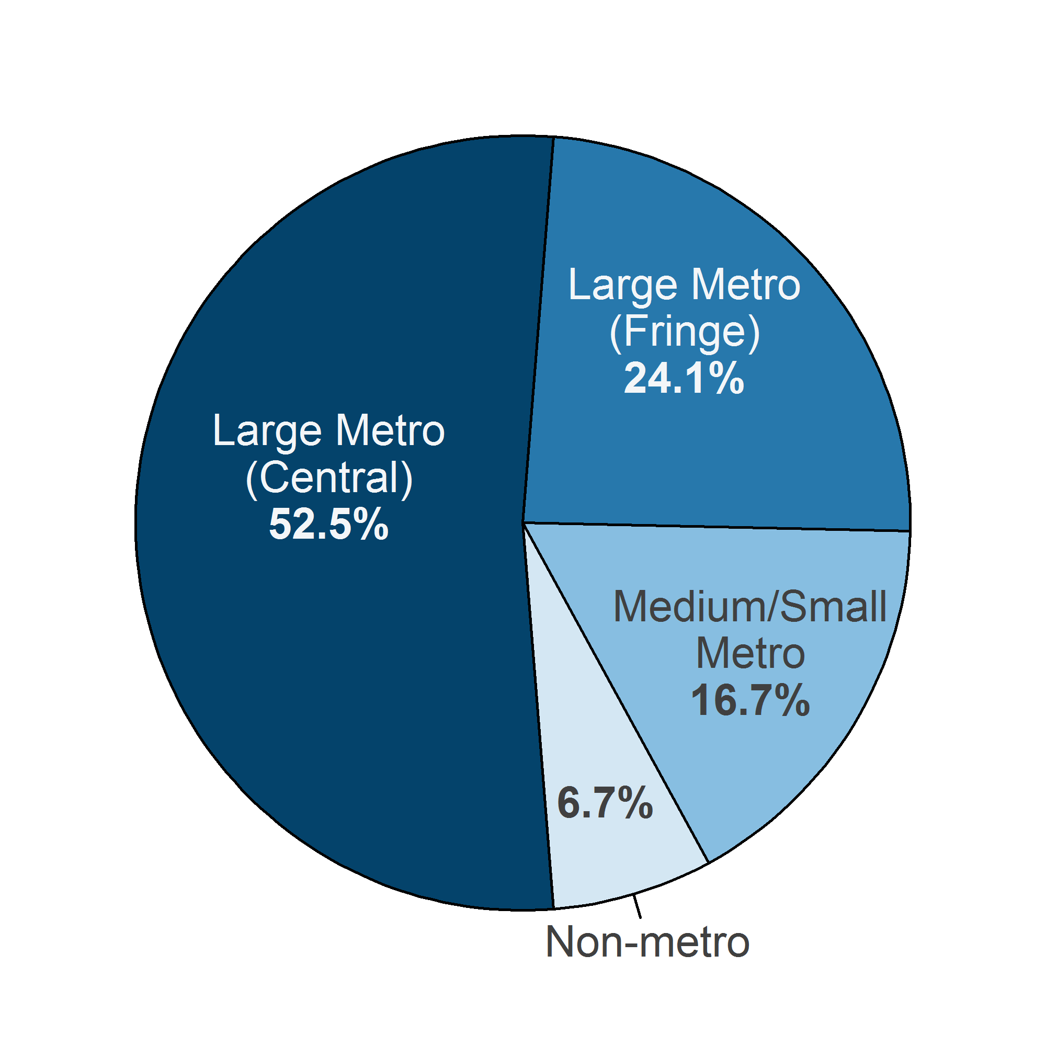
United States
Using the estimates, Emory CAMP created maps showing:
Number of MSM by US state
Percentage of MSM among adult men by US state
Number of MSM by US county
Percentage of MSM among adult men by US county
United States Highlights (2013)
Estimated men who had sex with men (MSM) in the past 5 years: 4,503,084
Largest state population of MSM: California, 792,750 (17.6% of all MSM in the United States)
Highest percentage of MSM among adult men in a state: Rhode Island, 6.0%
Percentage of MSM among adult men in the District of Columbia: 15.3%
Percentage of US MSM residing in central or fringe counties of large metropolitan areas: >75%
Notes:
Using the county-level estimates, Emory CAMP created maps of the number of MSM and the percentages of MSM among adult men for each US state and county.
There were an estimated 4,503,084 MSM in the United States in 2013, most (75%) of whom resided in large metropolitan areas.
California had the largest state population of MSM at 792,750, which was 17.6% of all MSM in the United States.
The largest percentage (17.6%) of US MSM lived in California, which had an estimated MSM population of 792,750.
Rhode Island had the highest percentage of MSM among its adult male population at 6.0%, although the percentage of MSM among adult men in Washington, DC, was much higher at 15.3%.

Slide 6
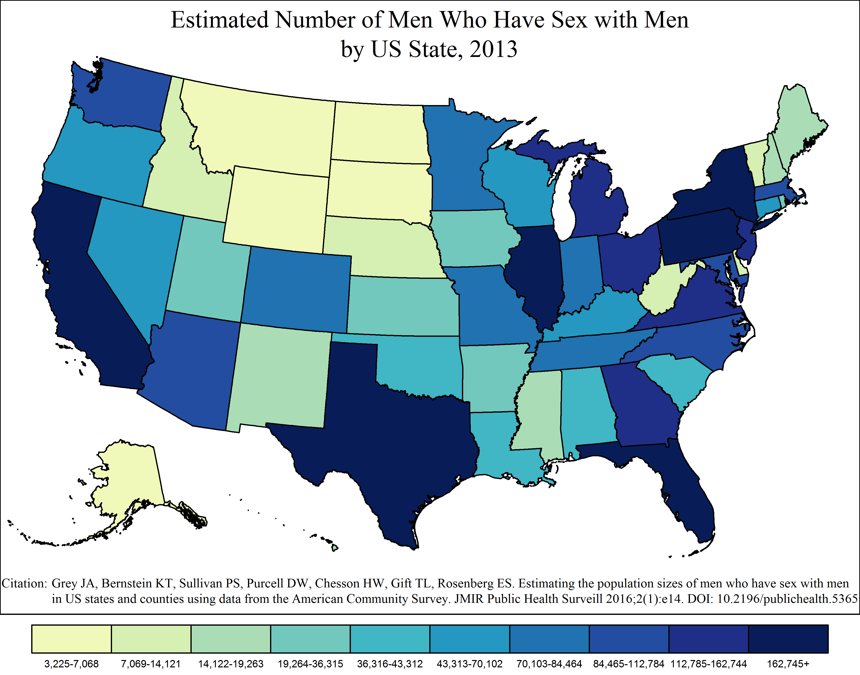
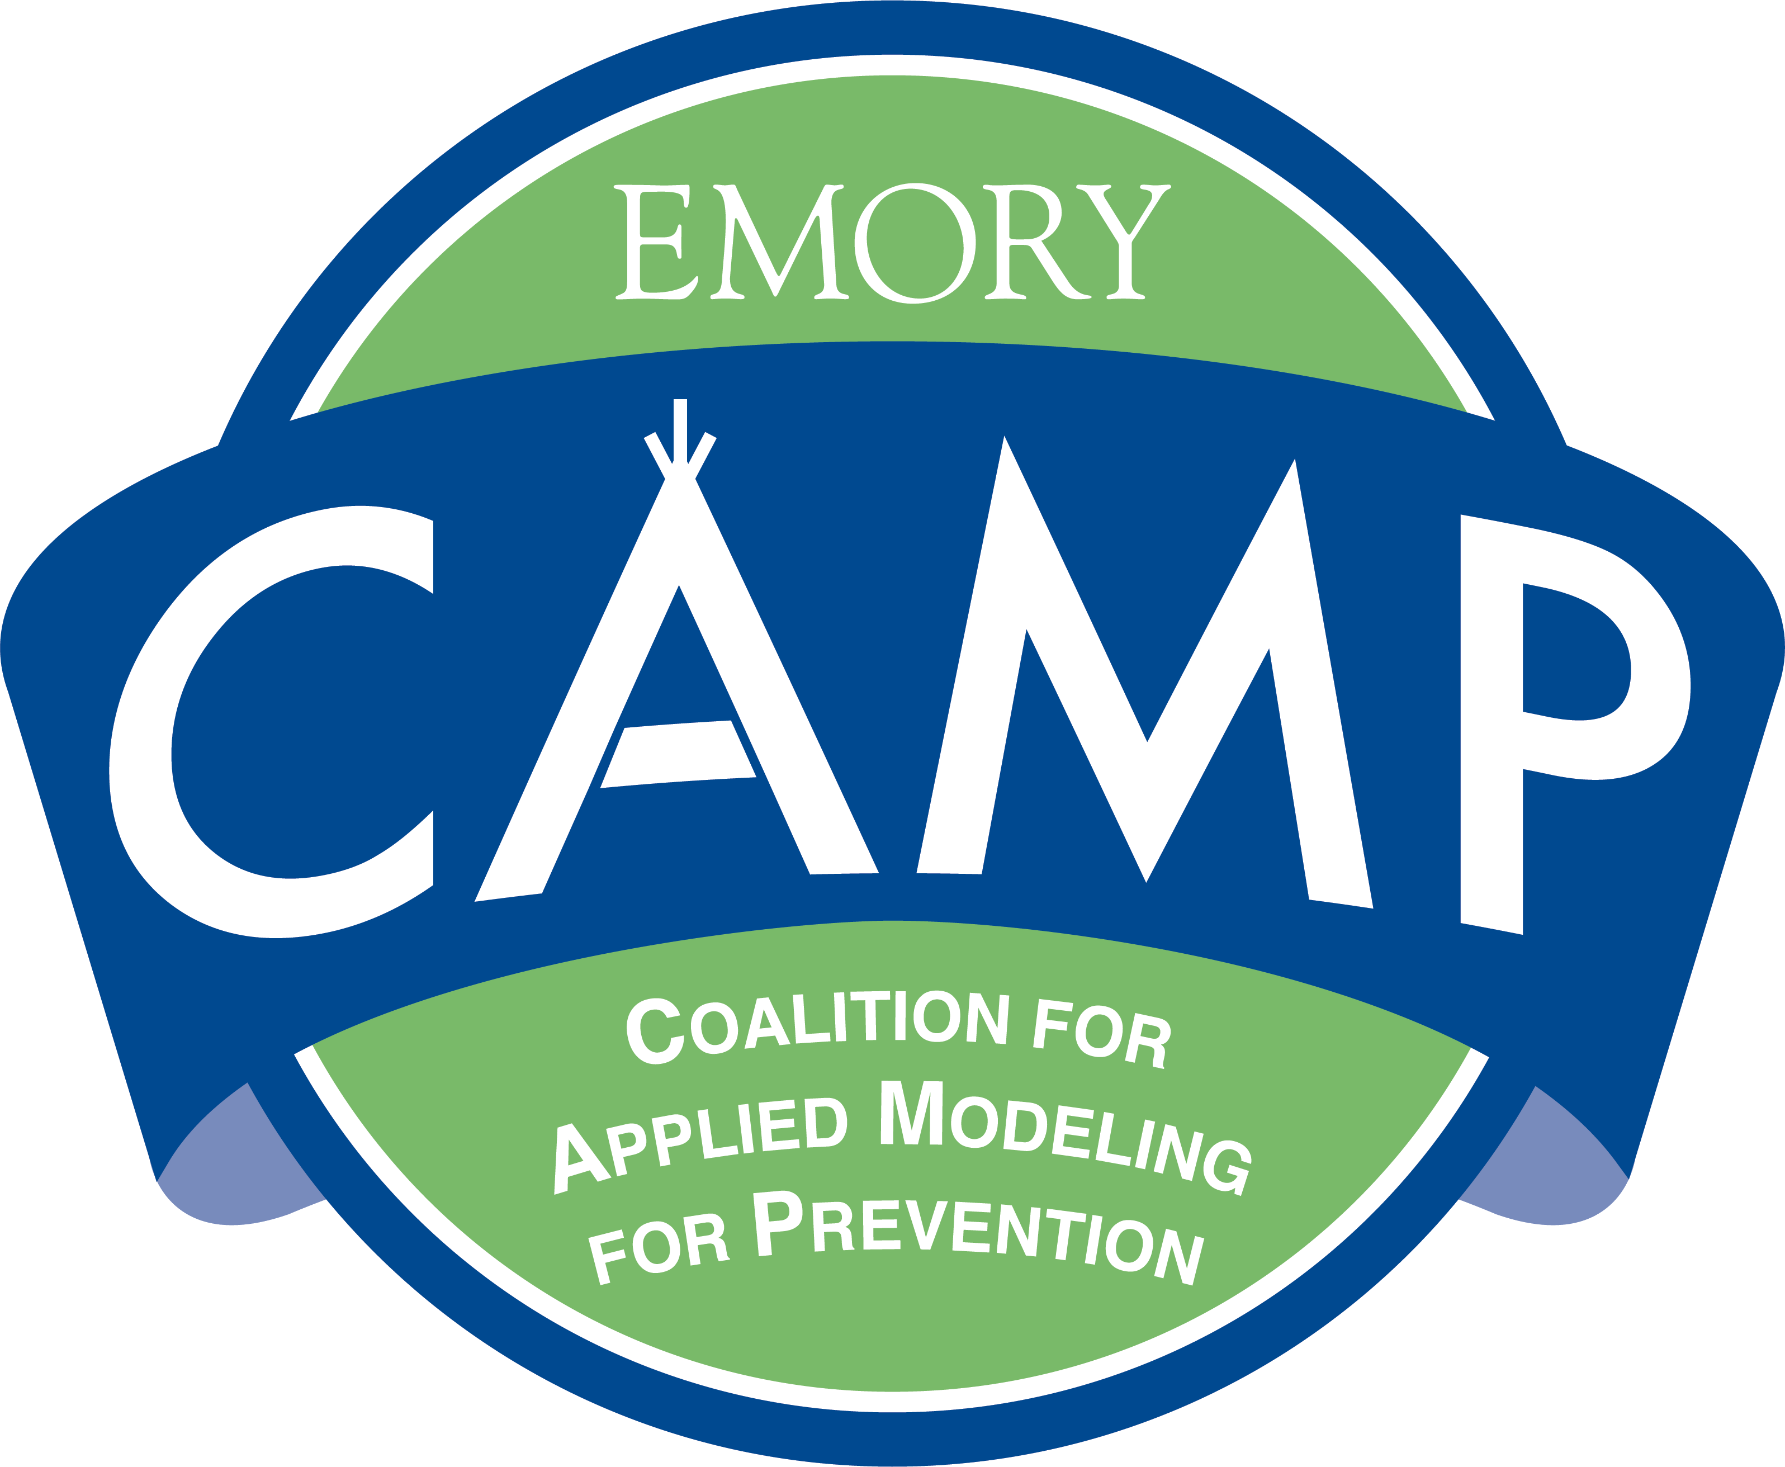
Estimated Number of Men Who Have Sex with Men by US State, 2013
Notes:
Estimated Number of Men Who Have Sex with Men by US State, 2013
This map shows the estimated number of men who have sex with men – defined has a man who had sex with a man in the past five years – in each state within the United States, as of 2013.
The color coding and intervals are based on the distribution for all states in the United States and were selected in order to show sufficient variation between areas.

Slide 7
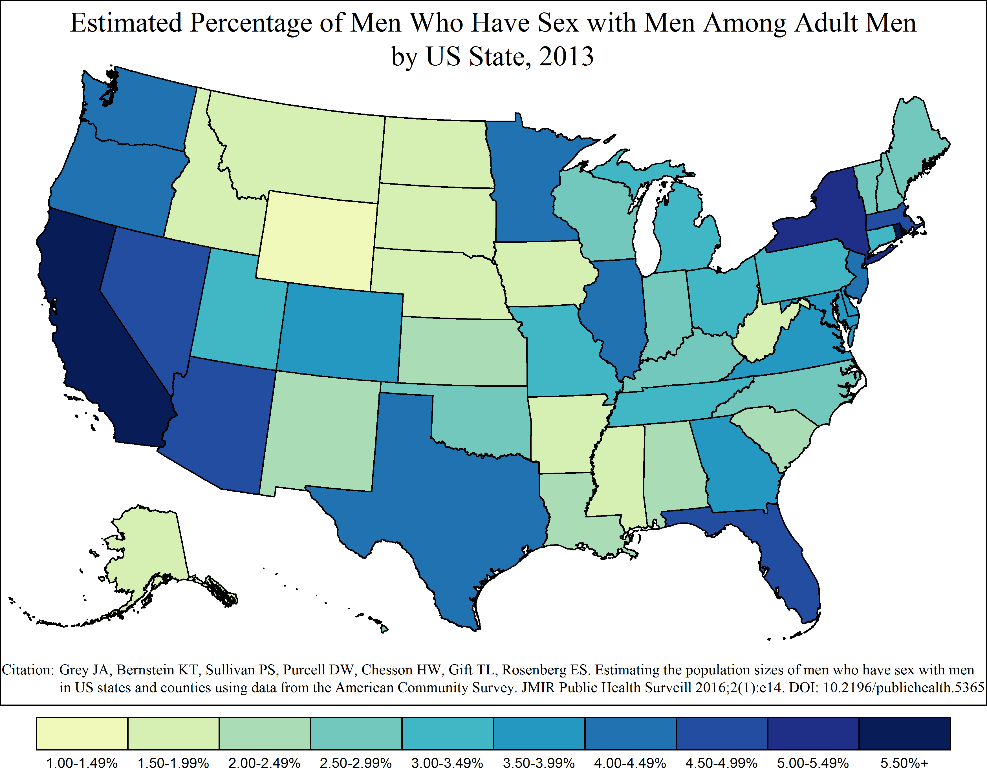
Estimated Percentage of Men Who Have Sex with Men Among Adult Men by US State, 2013
Notes:
Estimated Percentage of Men Who Have Sex with Men Among Adult Men by US State, 2013
This map shows the estimated percentage of all adult men in each state in the United States who had sex with a man in the past five years, as of 2013.
The color coding and intervals are based on the distribution for all states in the United States and were selected in order to show sufficient variation between areas.

Slide 8
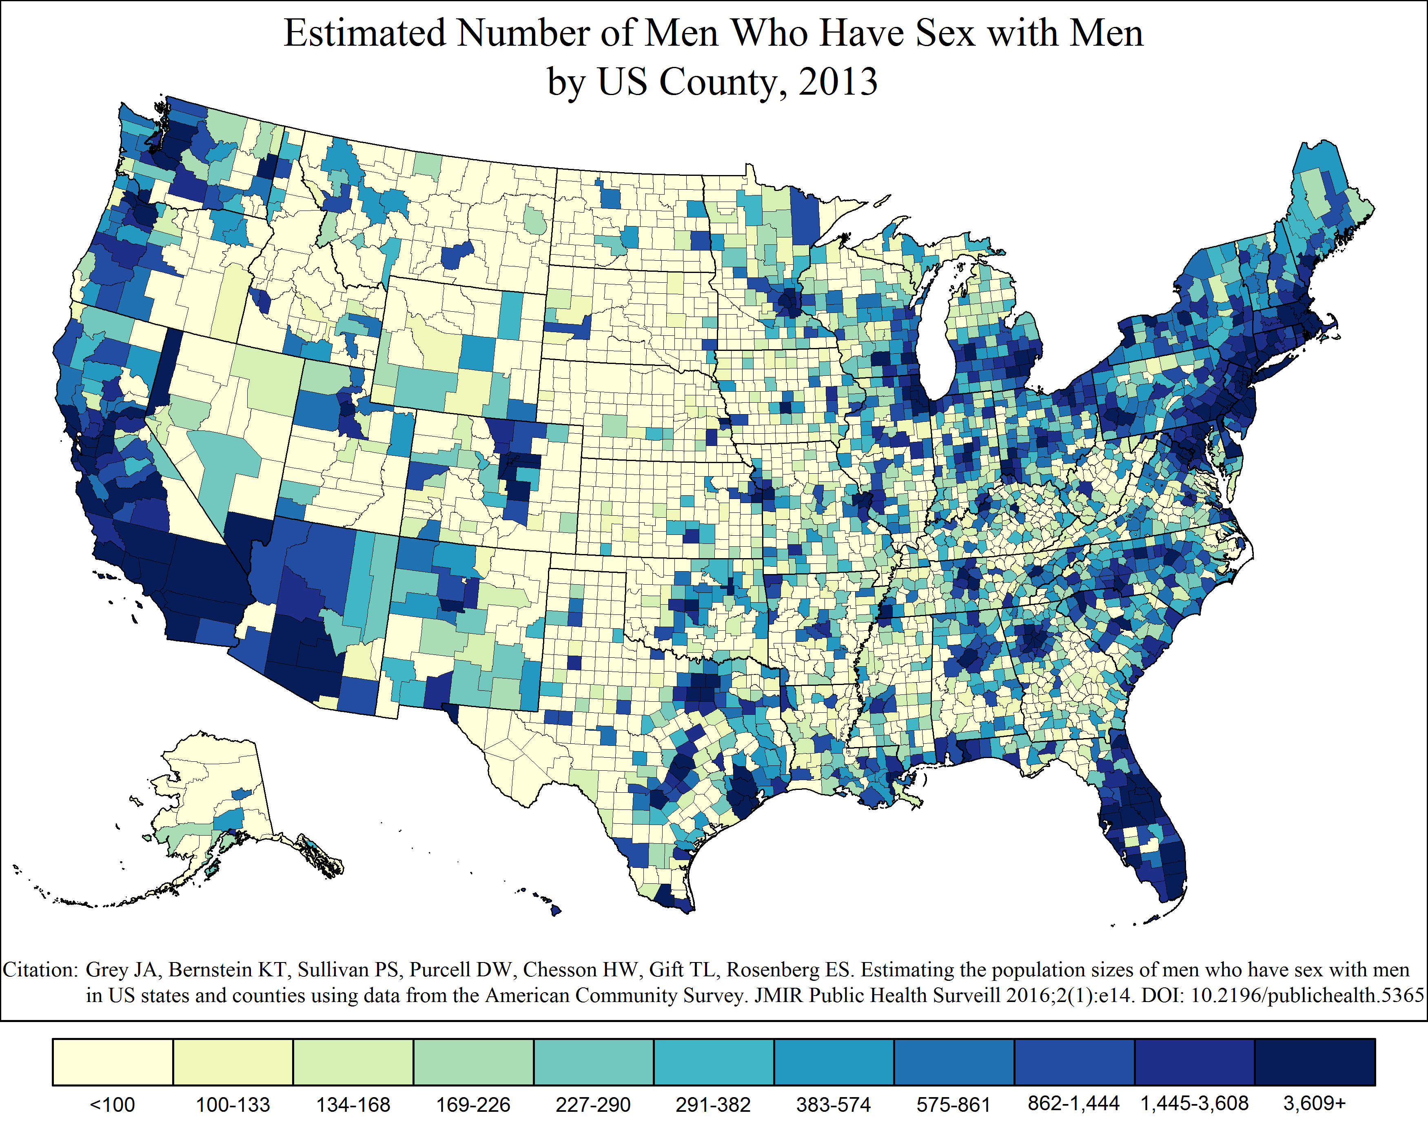
Estimated Number of Men Who Have Sex with Men by US County, 2013
Notes:
Estimated Number of Men Who Have Sex with Men by US County, 2013
This map shows the estimated number of men who have sex with men – defined has a man who had sex with a man in the past five years – in each county within the United States, as of 2013.
The color coding and intervals are based on the distribution for all counties in the United States and were selected in order to show sufficient variation between areas.

Slide 9
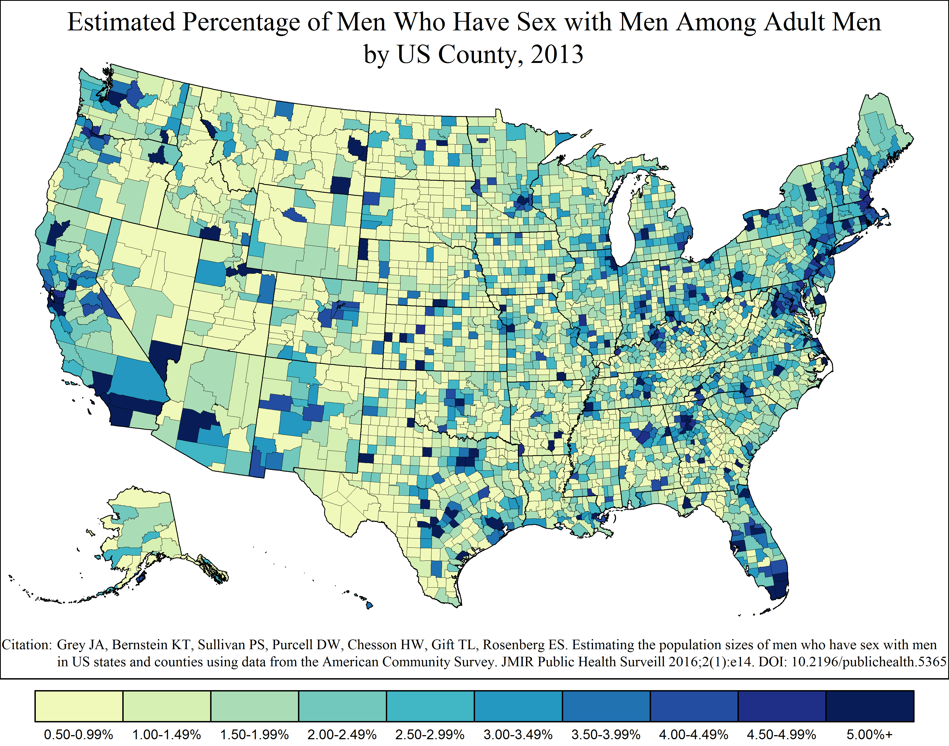
Estimated Percentage of Men Who Have Sex with Men Among Adult Men by US County, 2013
Notes:
Estimated Percentage of Men Who Have Sex with Men Among Adult Men in the United States by US County, 2013
This map shows the estimated percentage of all adult men in each county United States who had sex with a man in the past five years, as of 2013.
The color coding and intervals are based on the distribution for all counties in the United States and were selected in order to show sufficient variation between areas.

Slide 10
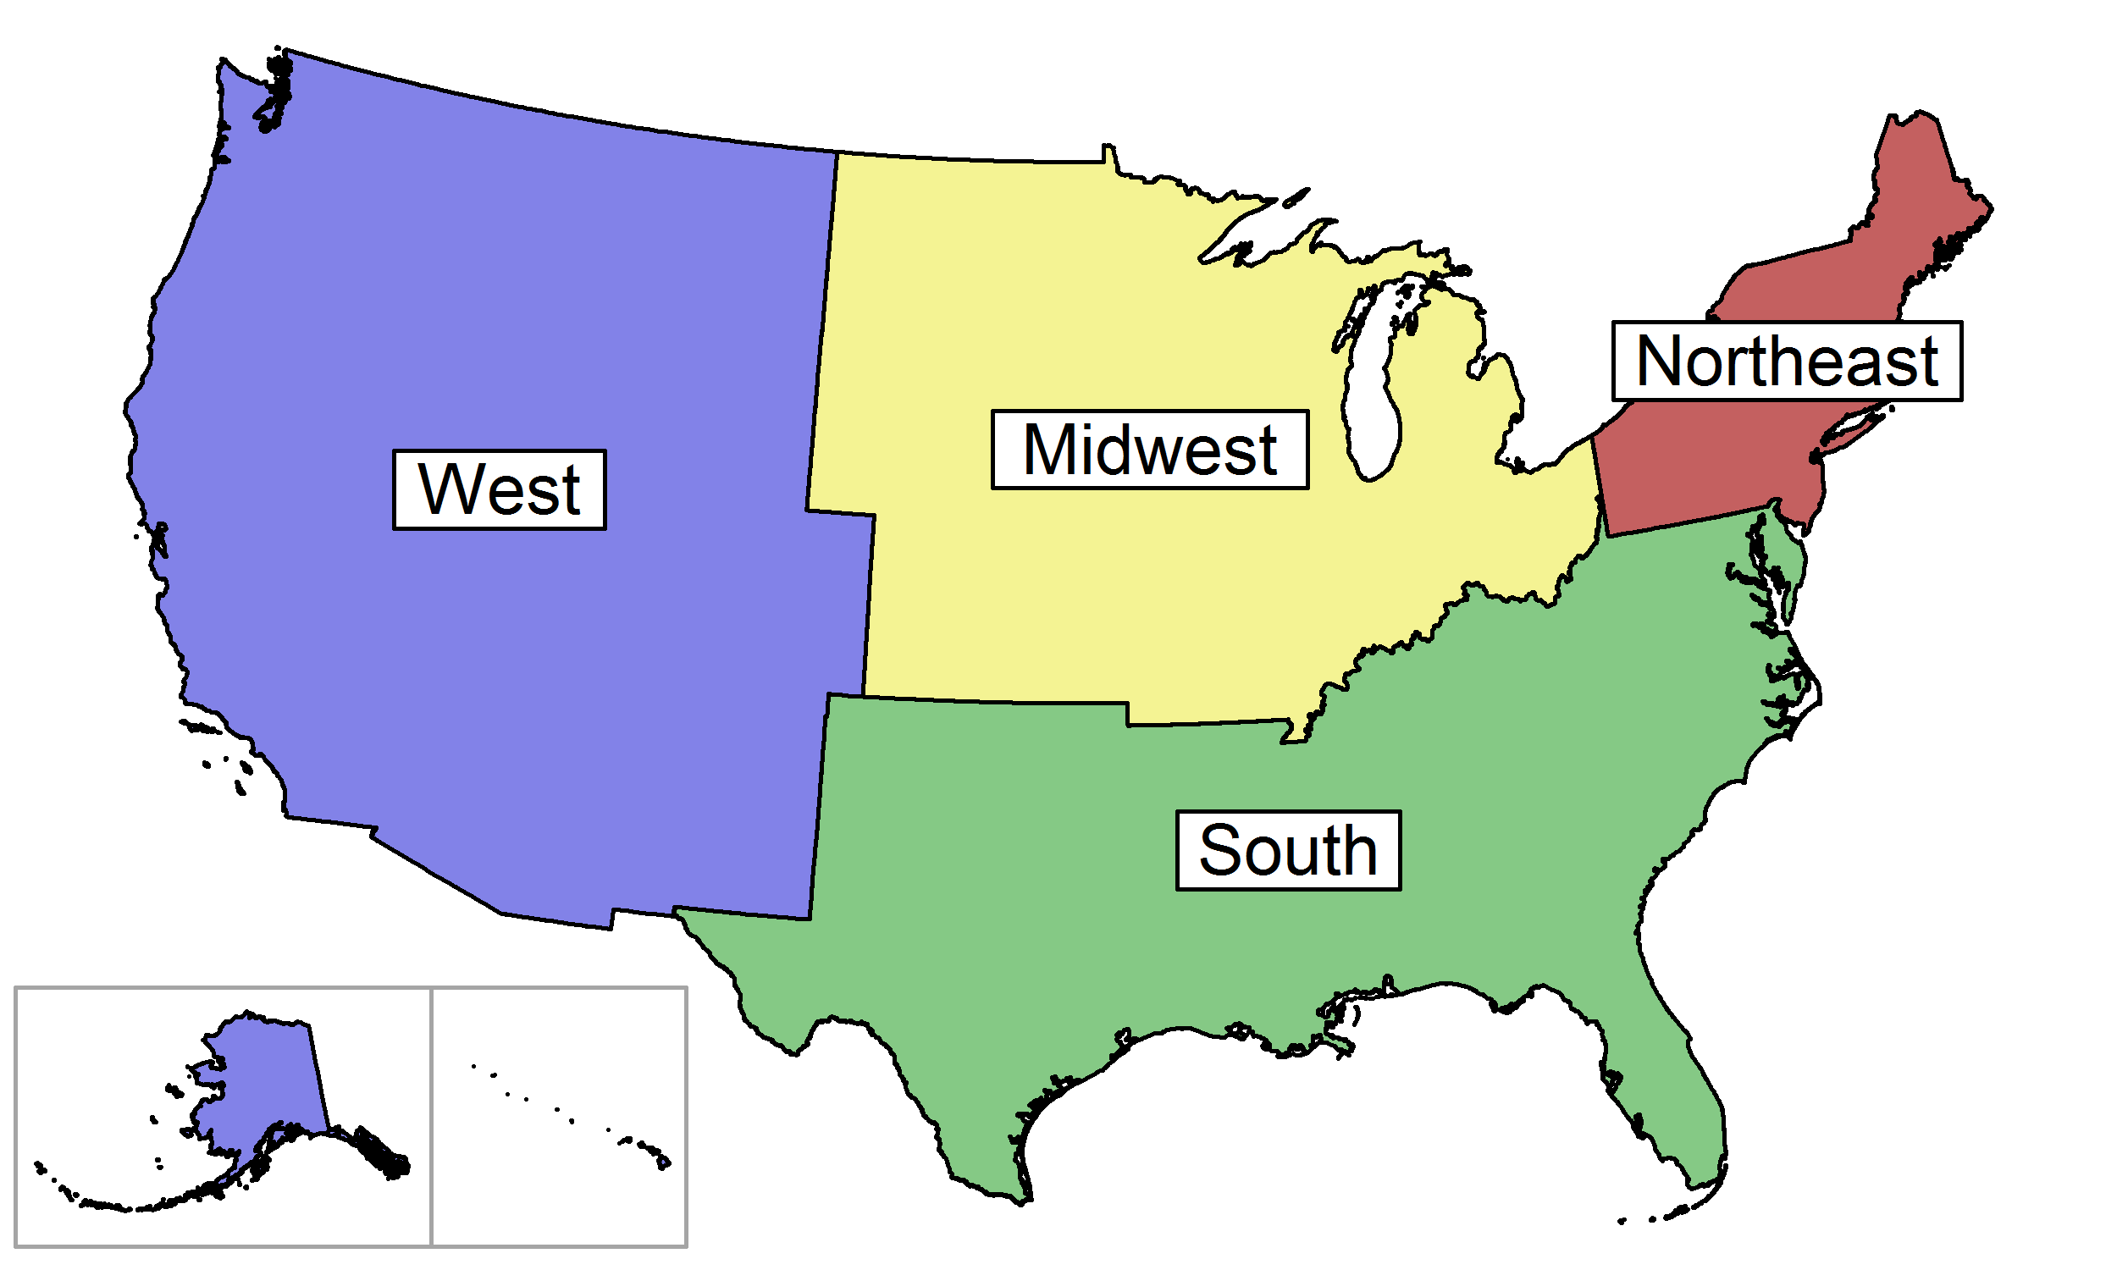
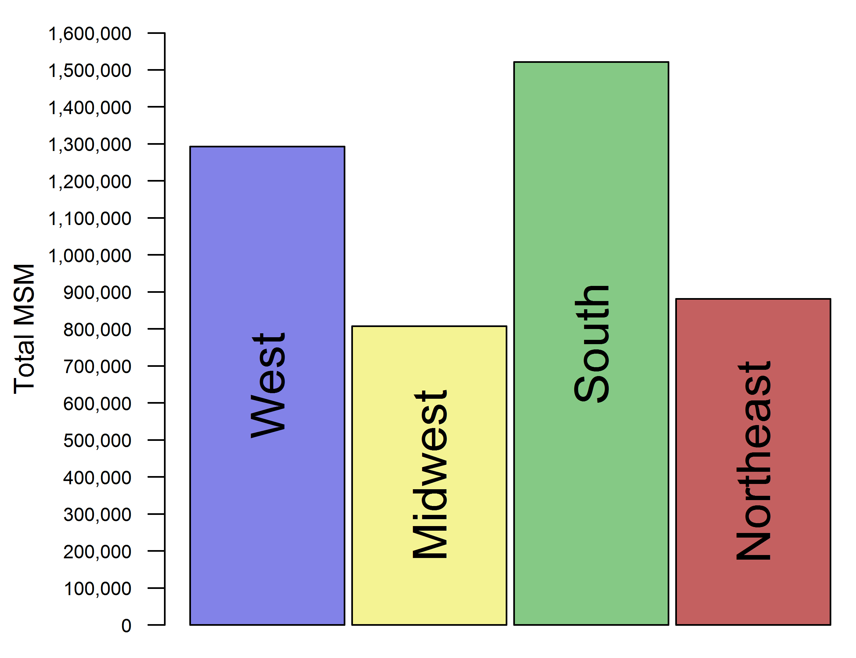
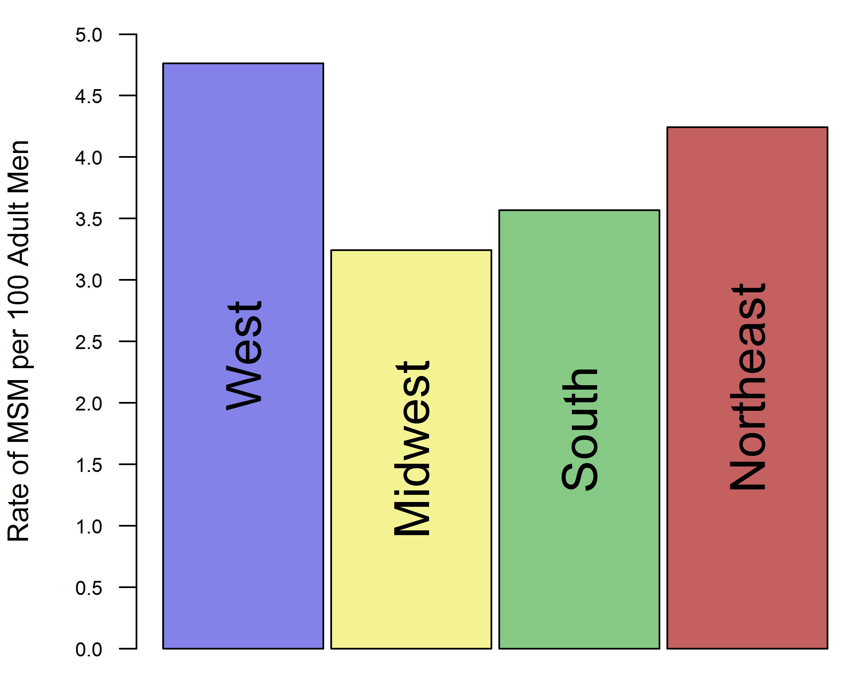
US Regions
Regional Highlights (2013)
Largest MSM population: South, 1,521,543 MSM
(33.8% of all MSM in the United States)
Smallest MSM population: Midwest, 807,174
(17.9% of all MSM in the United States)
Highest percentage of MSM among men: West, 4.8%
Lowest percentage of MSM among men: Midwest, 3.2%
Number of MSM by US Region
Percentage of MSM Among Adult Men by US Region
Notes:
The South had the most MSM of any US region in 2013, while the Midwest had the least.
The West had the highest percentage of MSM among its adult male population, while the Midwest had the lowest.

Slide 11
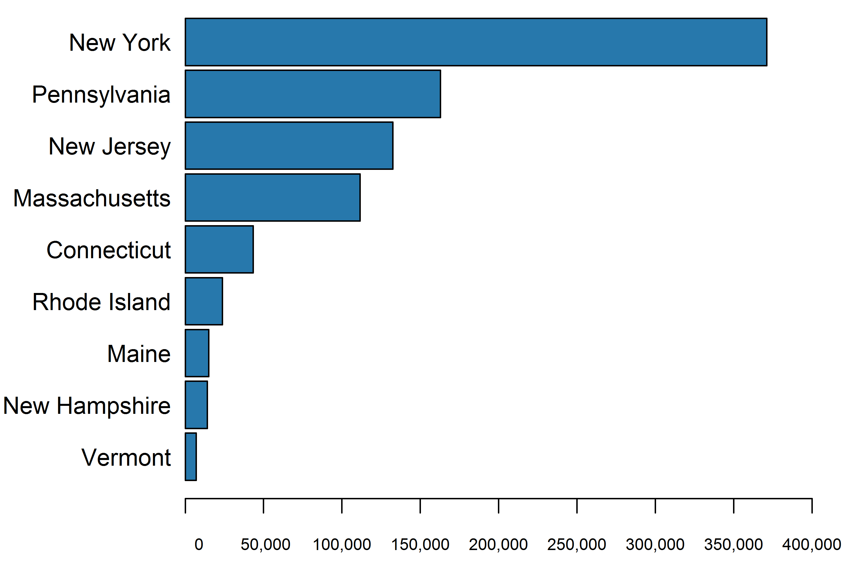
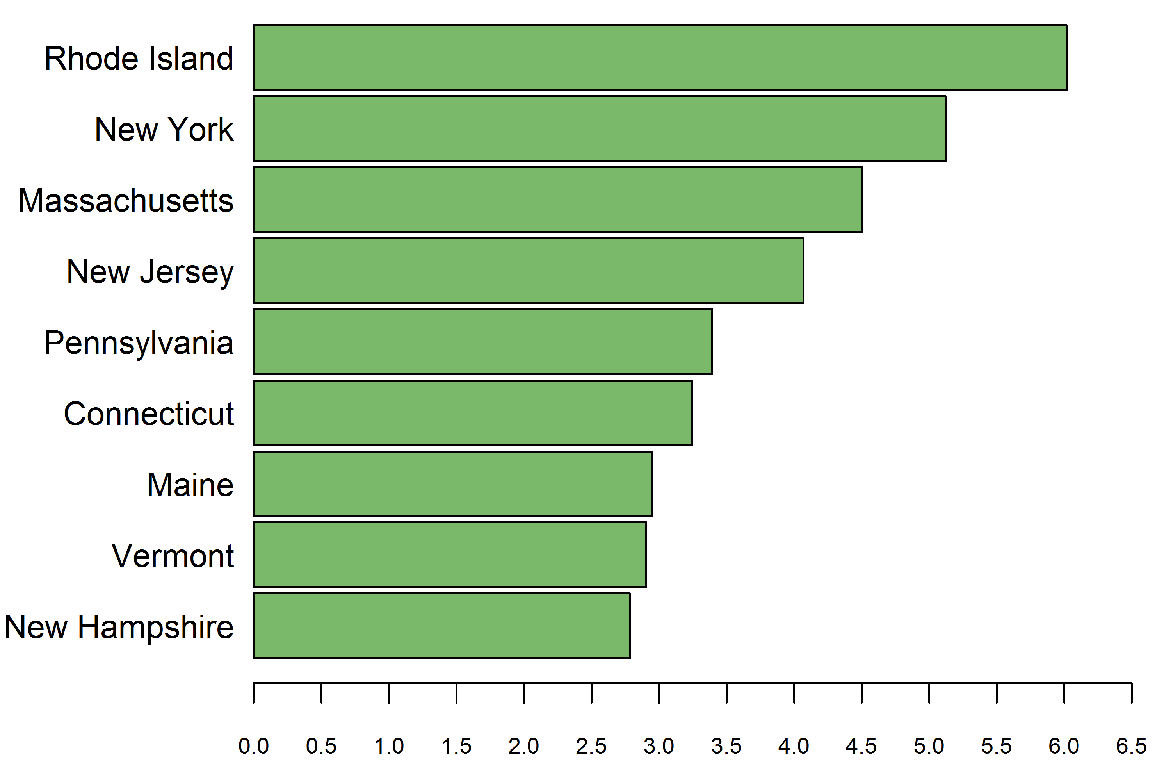
States in the Northeast
Largest MSM population: | New York, 371,087 MSM
Smallest MSM population: | Vermont, 7,069 MSM
Highest percentage of MSM among adult men: | Rhode Island, 6.0%
Lowest percentage of MSM among adult men: | New Hampshire, 2.8%
Number of MSM in States in the Northeast
Percentage of MSM Among Adult Men in States in the Northeast
Notes:
New York had the largest MSM population of any state in the US Northeastern Region in 2013, while Vermont had the smallest.
Among adult men residing in states in the Northeast in 2013, Rhode Island had the highest percentage who had had sex with another man in the past five years, while New Hampshire had the lowest.
The graph on the left shows the estimated MSM population sizes of states in the US Northeastern Region, ranked in descending order by the number of MSM in the state.
The graph on the right shows the estimated percentage of MSM among adult men in states within the US Northeastern Region, ranked in descending order by the percentage MSM among of adult men in the state.

Slide 12
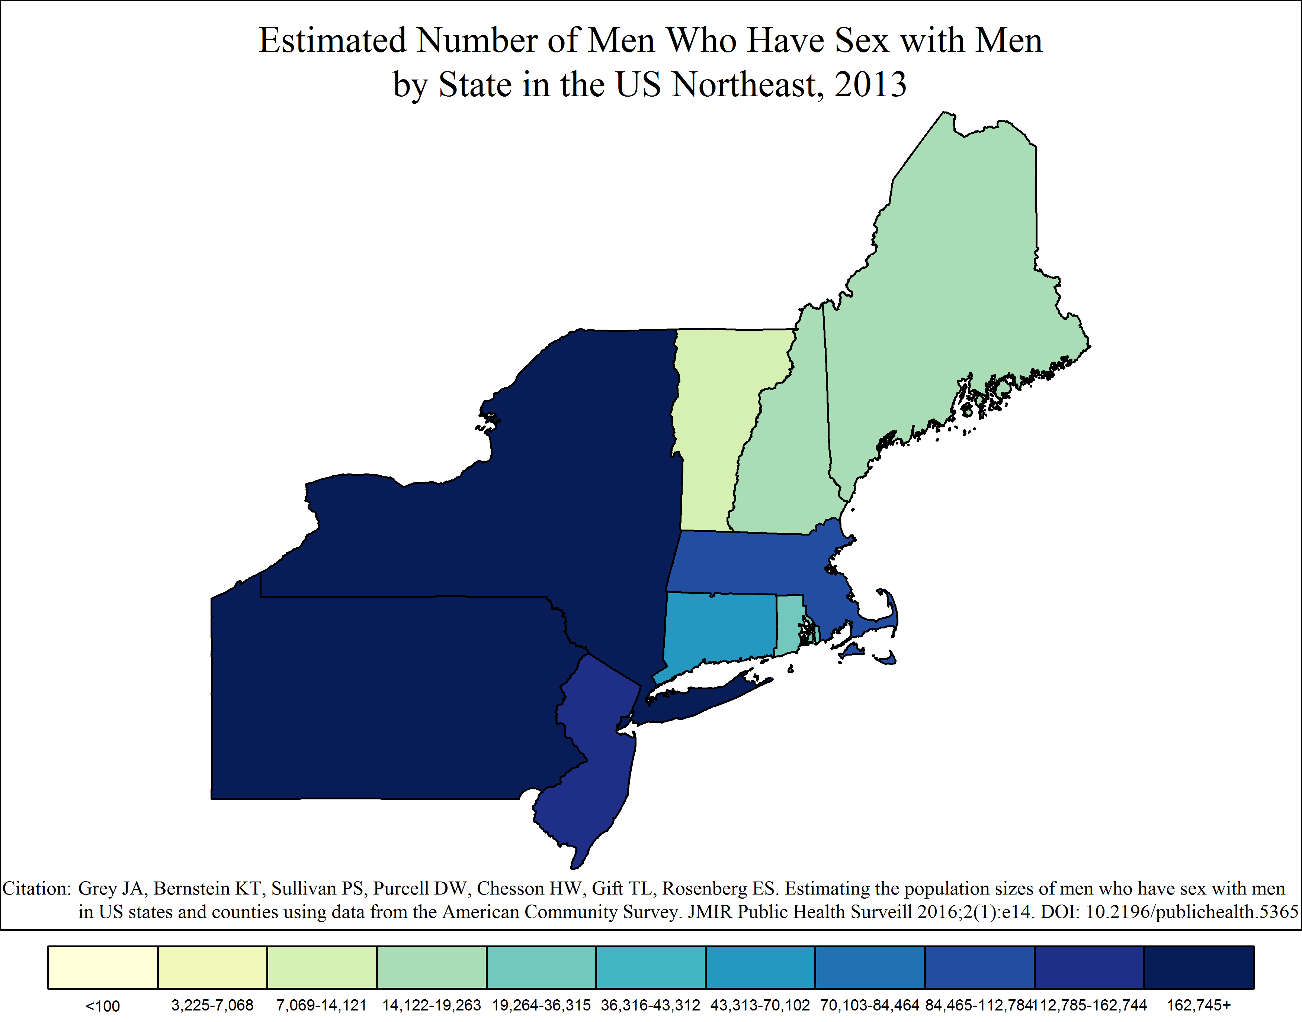
Estimated Number of Men Who Have Sex with Men by State in the US Northeast, 2013
Notes:
Estimated Number of Men Who Have Sex with Men by State in the US Northeast, 2013
This map shows the estimated number of men who have sex with men – defined has a man who had sex with a man in the past five years – in each state within the US Northeastern Region, as of 2013.
The color coding and intervals are based on the distribution for all states in the United States and were selected in order to show sufficient variation between areas.

Slide 13
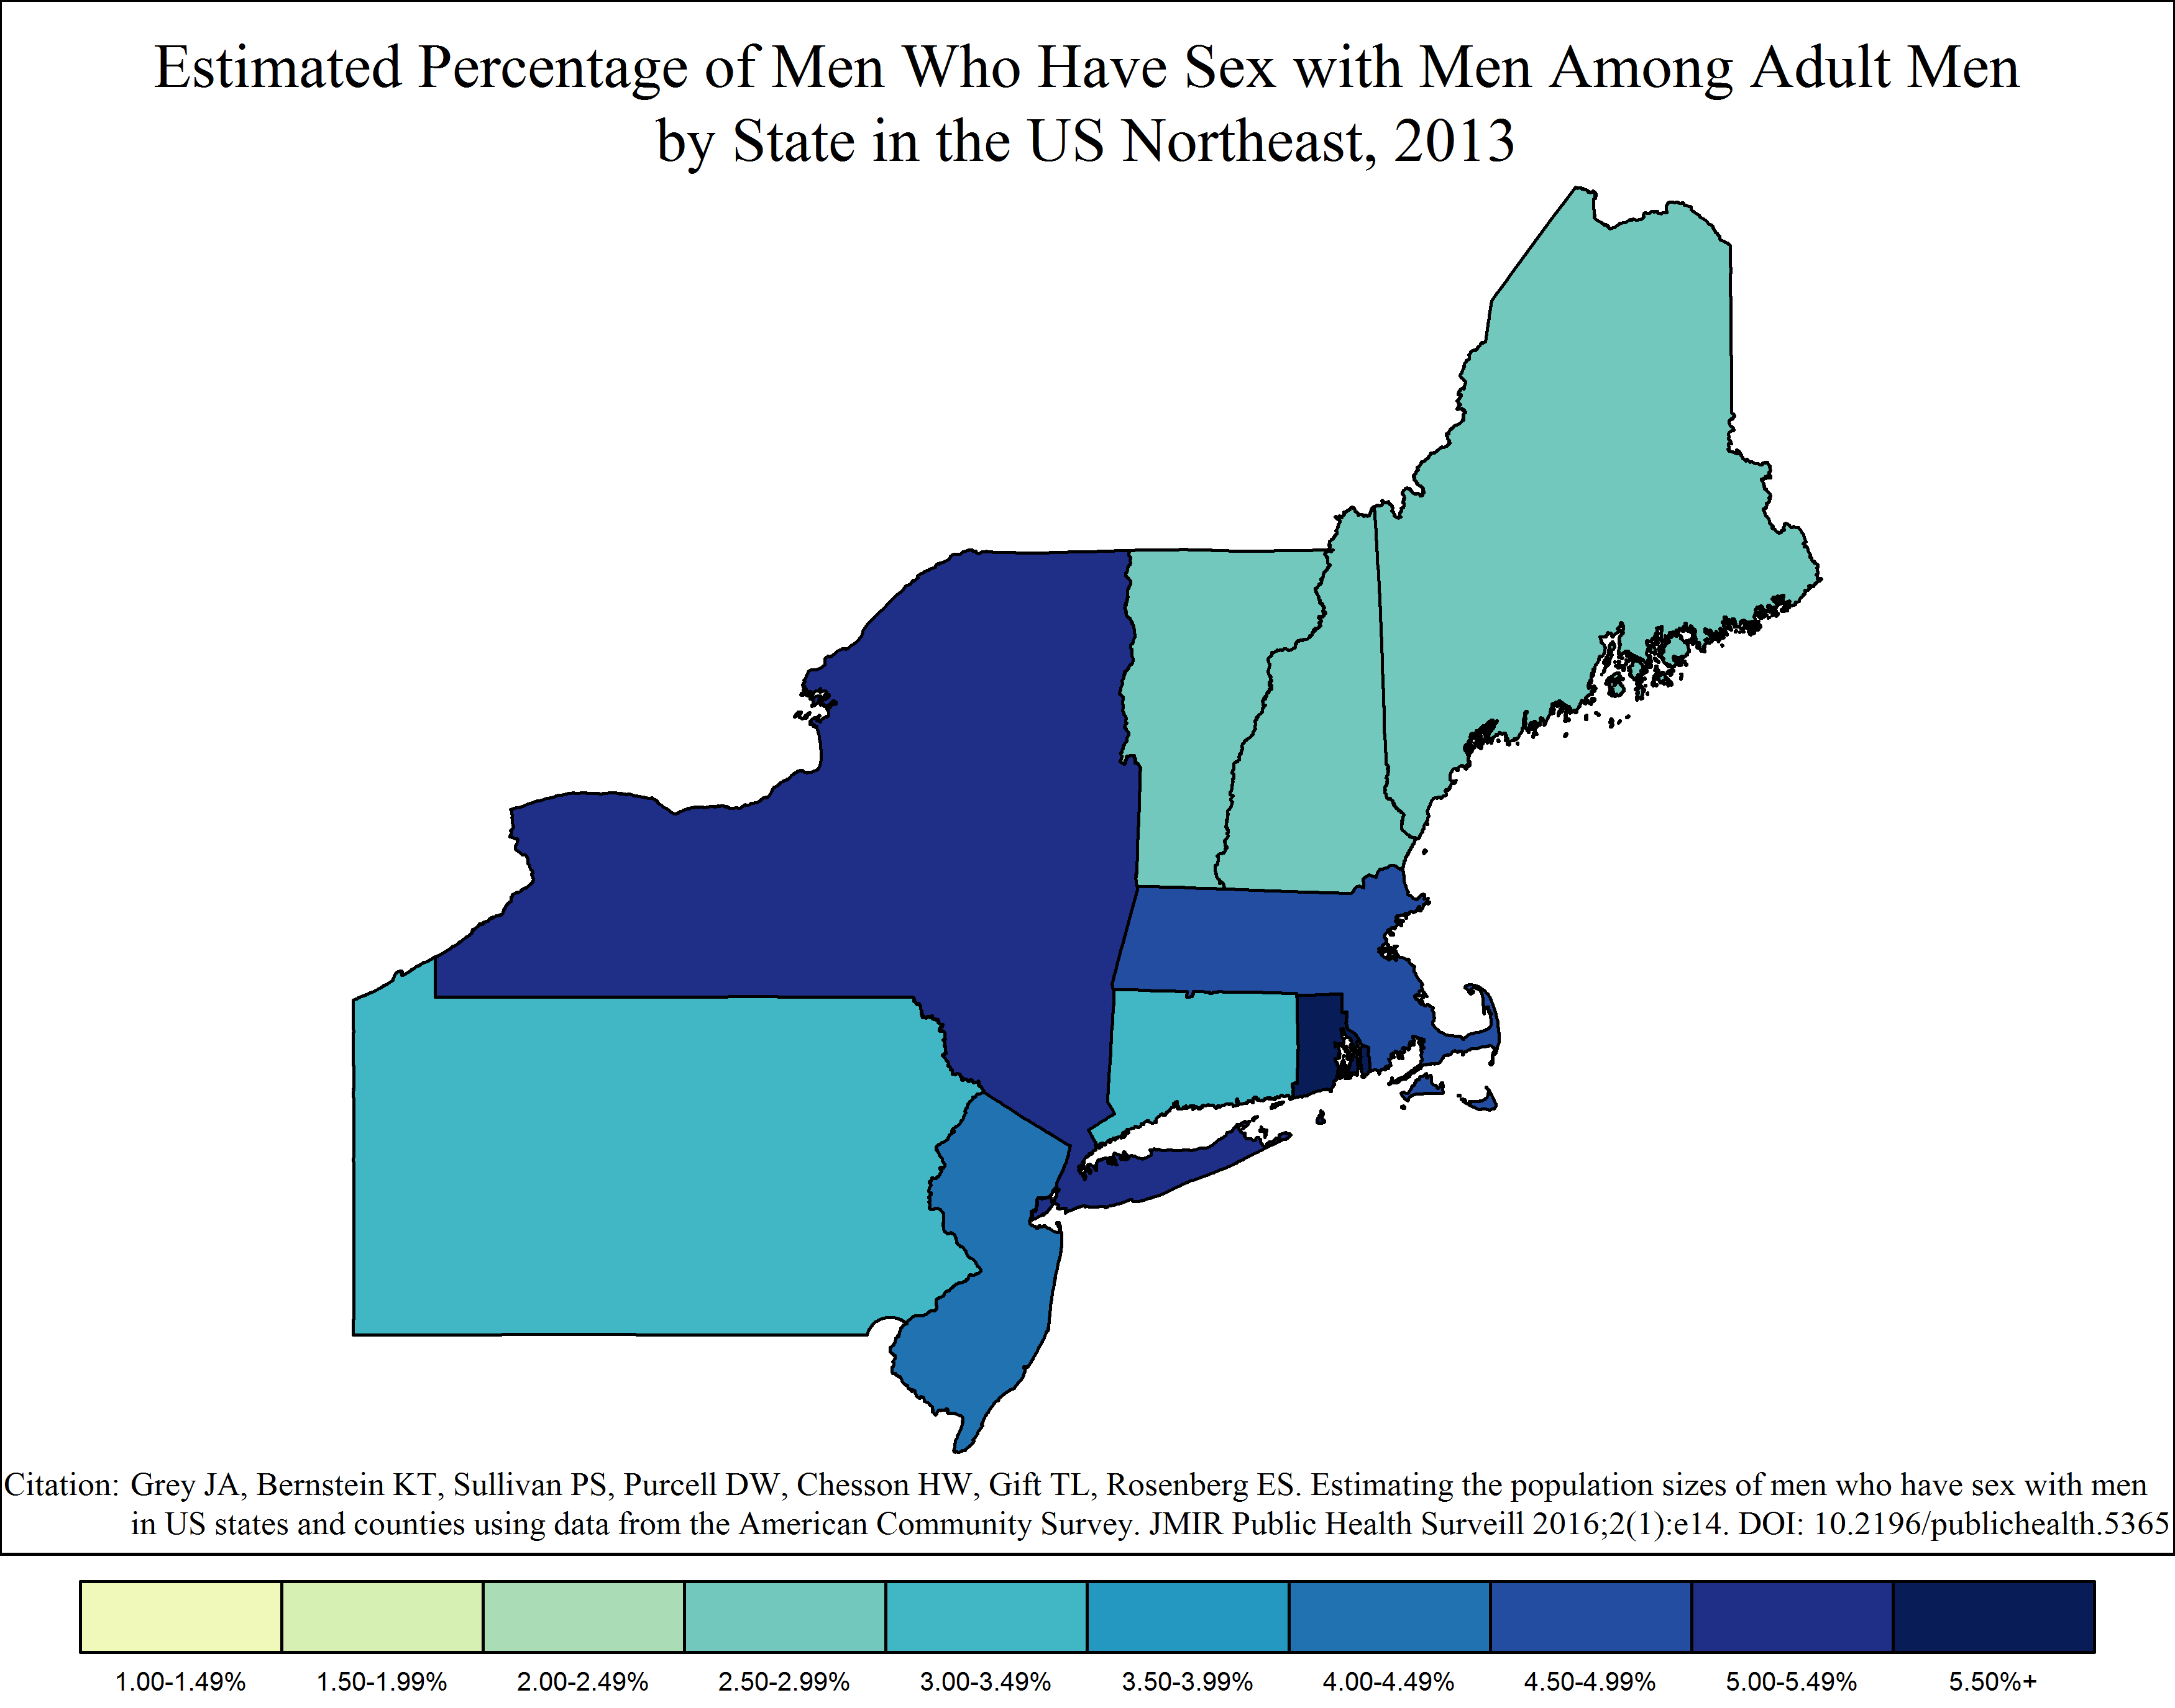
Estimated Percentage of Men Who Have Sex with Men Among Adult Men by State in the US Northeast, 2013
Notes:
Estimated Percentage of Men Who Have Sex with Men Among Adult Men by State in the US Northeast, 2013
This map shows the estimated percentage of all adult men in each state within the US Northeastern Region who had sex with a man in the past five years, as of 2013.
The color coding and intervals are based on the distribution for all states in the United States and were selected in order to show sufficient variation between areas.

Slide 14
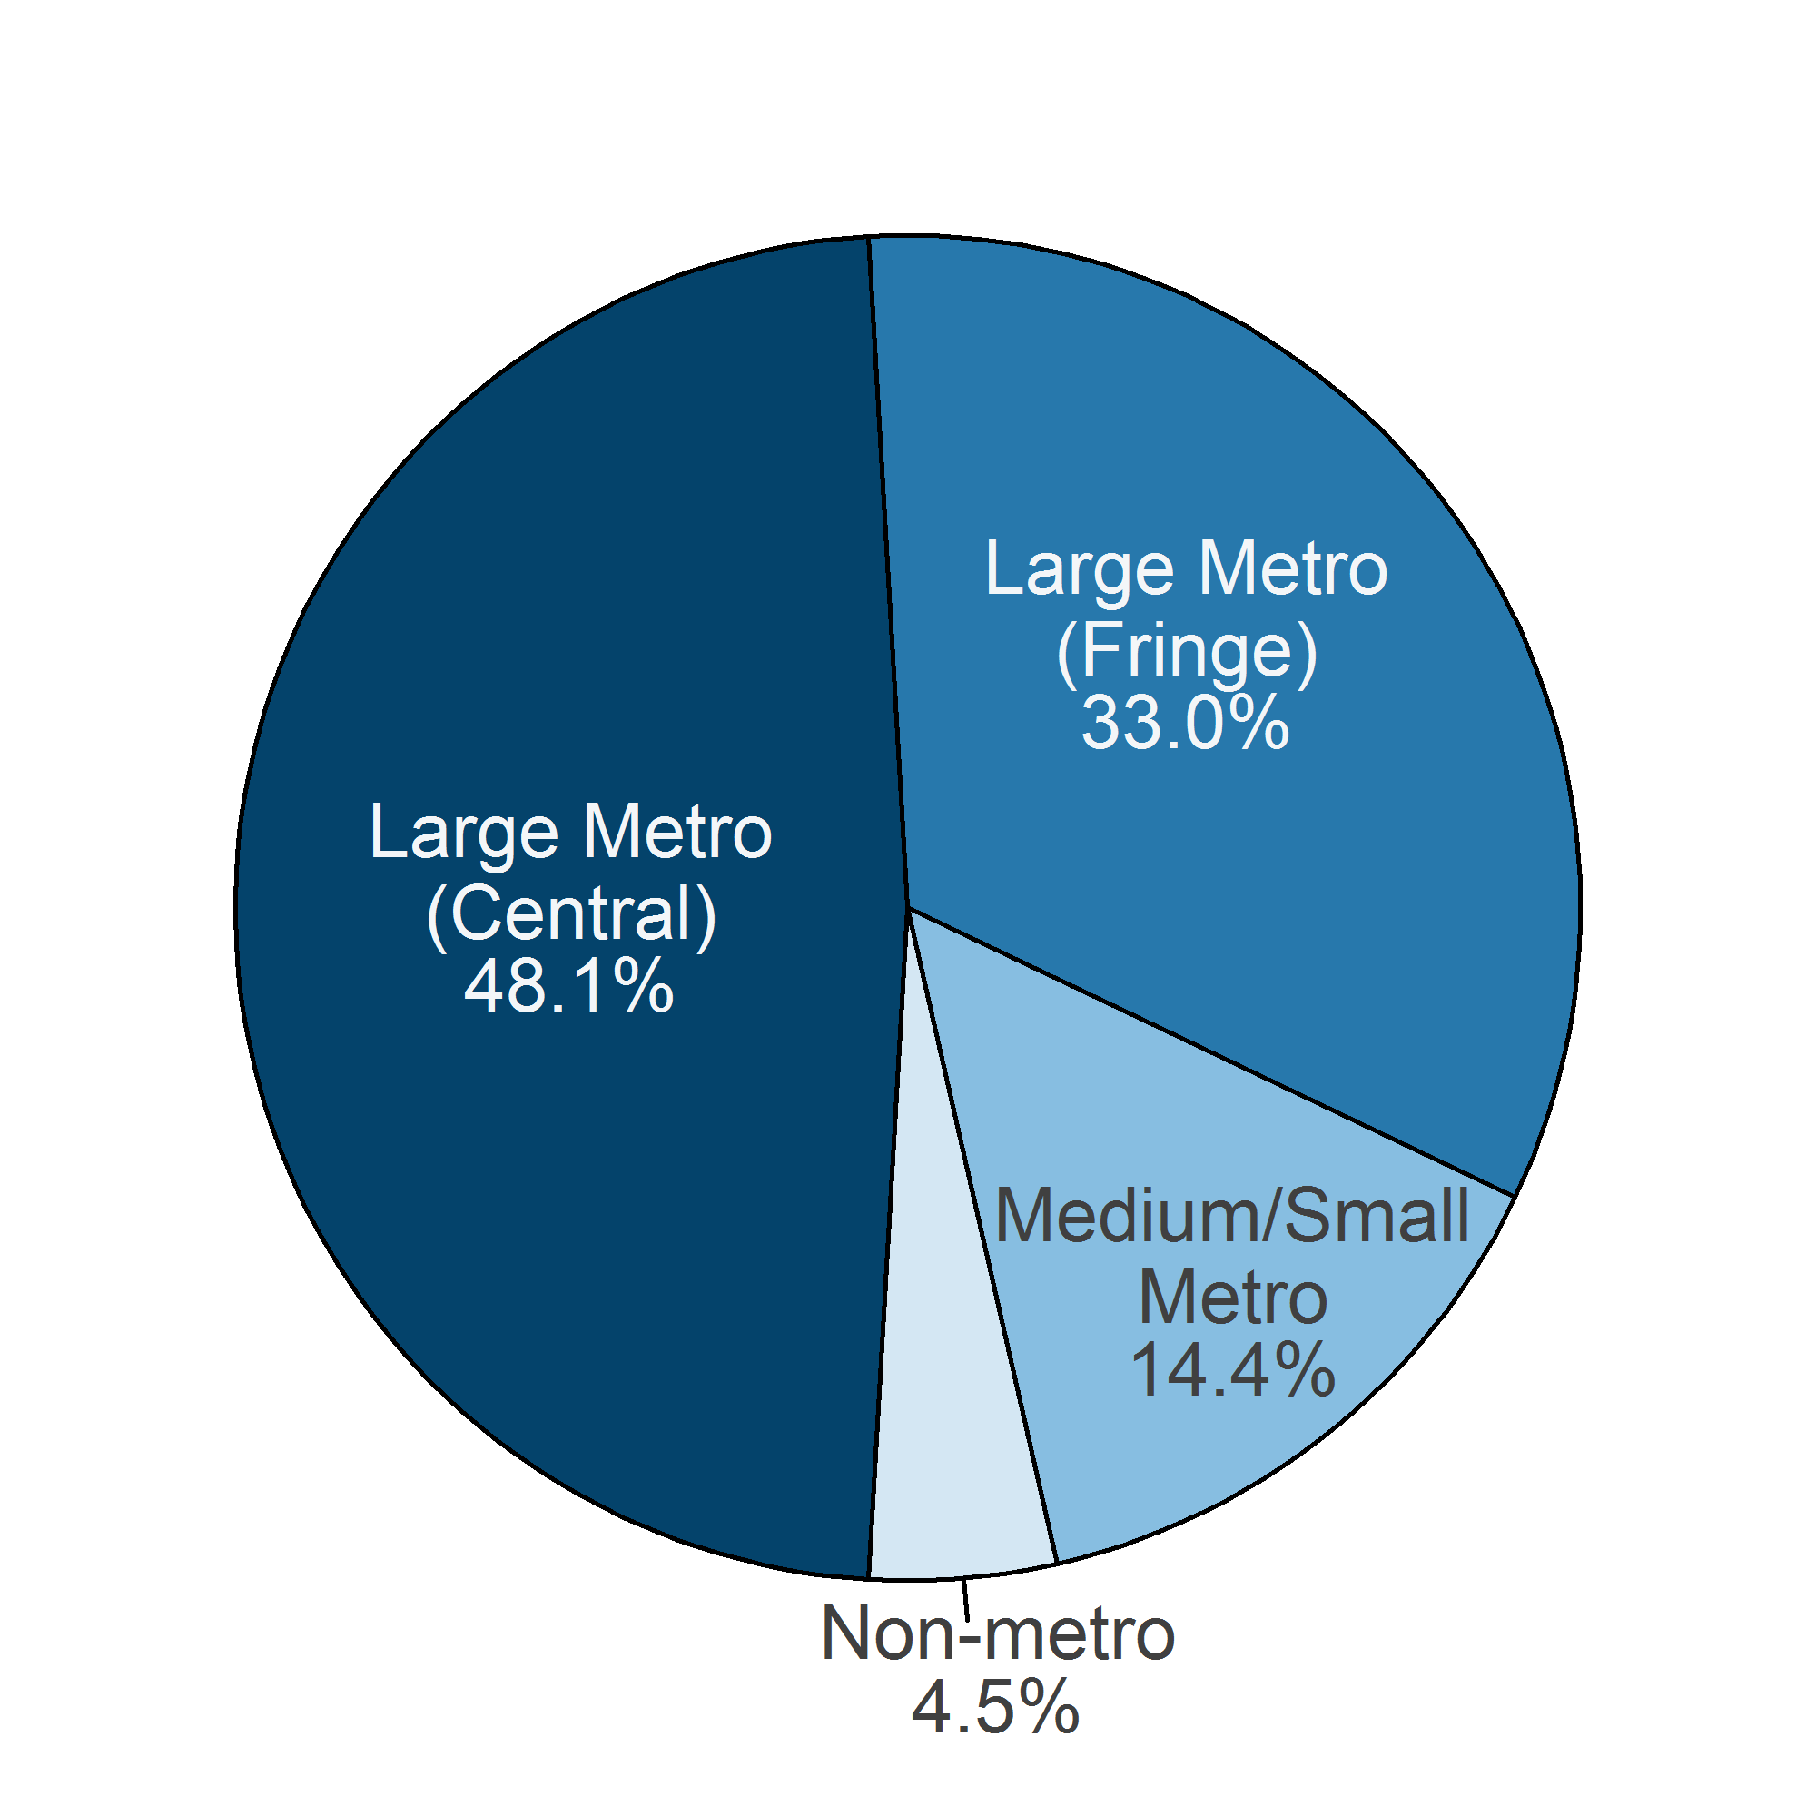
Counties in the Northeast
Approximately 81% of MSM in the Northeast (715,159 of 881,368) resided in central or fringe counties of large metropolitan areas.
Over 50% (441,498) resided in one of 14 counties or county-equivalent areas.
14 counties or county-equivalent areas in the US Northeast where over half of the MSM in the region resided, in alphabetical order by state and county
State | County or Equivalent | MSM (2013)
Connecticut | Hartford County | 16,767
Massachusetts | Middlesex County Suffolk County | 28,122 26,338
New Jersey | Hudson County | 18,523
New York | Bronx County Erie County Kings County Monroe County New York County Queens County Suffolk County | 22,370 18,706 59,767 15,858 87,556 45,656 24,597
Pennsylvania | Allegheny County Philadelphia County | 26,666 33,549
Rhode Island | Providence County | 17,022
Notes:
81% of MSM who resided in counties in the US Northeastern Region resided in large metropolitan areas.
Over half of MSM in the US Northeast resided in one of 14 counties or county-equivalent areas in six states. These counties and their MSM population sizes are displayed in the table to the right.

Slide 15
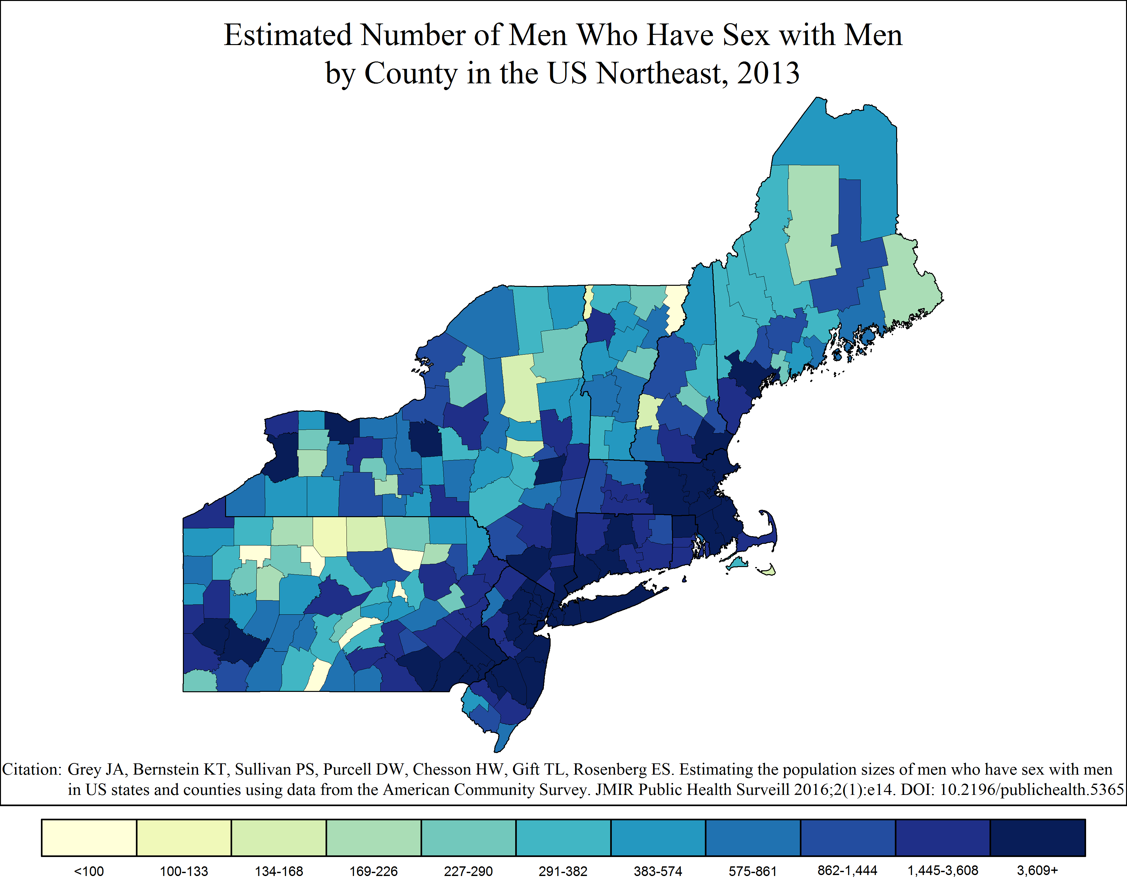
Estimated Number of Men Who Have Sex with Men by County in the US Northeast, 2013
Notes:
Estimated Number of Men Who Have Sex with Men by County in the US Northeast, 2013
This map shows the estimated number of men who have sex with men – defined has a man who had sex with a man in the past five years – in each county within the US Northeastern Region, as of 2013.
The color coding and intervals are based on the distribution for all counties in the United States and were selected in order to show sufficient variation between areas.

Slide 16
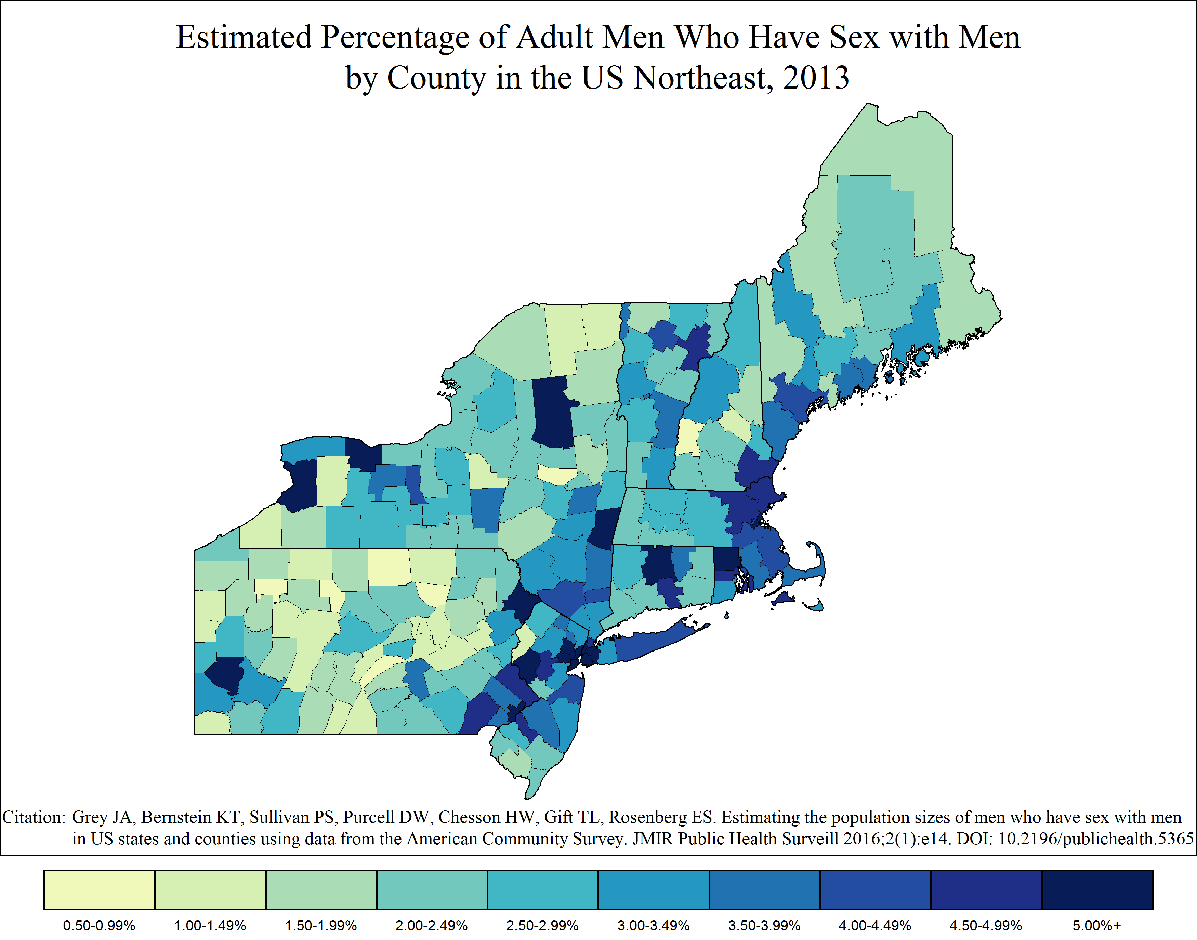
Estimated Percentage of MSM Among Adult Men by County in the US Northeast, 2013
Notes:
Estimated Percentage of Men Who Have Sex with Men Among Adult Men by County in the US Northeast, 2013
This map shows the estimated percentage of all adult men in each county within the US Northeastern Region who had sex with a man in the past five years, as of 2013.
The color coding and intervals are based on the distribution for all counties in the United States and were selected in order to show sufficient variation between areas.

Slide 17
Caveats & Limitations of Maps
The statistics and maps reflect indirect estimates based on same-sex households, male population sizes, and behavioral findings from peer-reviewed publications. Behavioral data were not collected directly.
The data used to construct the estimates are from pooled, five-year American Community Survey (ACS) summary files. Therefore, they reflect data collected over a period of time.
Map users should exercise caution when interpreting data from areas with few estimated MSM (e.g., <100) and with sparse populations in general.
Notes:
The MSM population size estimates were derived from published estimates of same-sex behavior among adult men in the United States and recent estimates of adult male population sizes and same-sex households from the American Community Survey. These data were not collected directly as part of a census or a population-based survey.
The American Community Survey collects data from a sample of the US population annually. Data are released as 1-, 3-, and 5-year summary files. Data regarding the number of adult males and the number of households with same-sex male couples in each county are available only as 5-year pooled summary data, which means that the data reflect five years of survey data and may not reflect recent changes in the number of adult males or of same-sex male households.
MSM population sizes in areas with few individuals should be interpreted with caution. Fewer data are available from these areas, so slight variations in those data result in large variations in the estimated number of MSM. Although the method includes steps to impute MSM to areas with less data, less populous areas may still have unstable estimates.

Slide 18
Additional Resources
For information regarding the American Community Survey (ACS), including sampling and data considerations, visit the Census Bureau’s ACS site: https://www.census.gov/programs-surveys/acs/
For information regarding the methodology or underlying assumptions, refer to the following articles:
Grey JA, Bernstein KT, Sullivan PS, Purcell DW, Chesson HW, Gift TL, Rosenberg ES. Estimating the population sizes of men who have sex with men in US states and counties using data from the American Community Survey. JMIR Public Health Surveill 2016;2(1):e14. DOI: 10.2196/publichealth.5365
Oster AM, Sternberg M, Lansky A, Broz D, Wejnert C, Paz-Bailey G. Population size estimates for men who have sex with men and persons who inject drugs. J Urban Health 2015;92(4):733-743. DOI: 10.1007/s11524-015-9970-3
Purcell DW, Johnson CH, Lansky A, Prejean J, Stein R, Denning P, Gau Z, Weinstock H, Su J, Crepaz N. Estimating the population size of men who have sex with men in the United States to obtain HIV and syphilis rates. Open AIDS 2012;6(Suppl 1):98-107. DOI: 10.2174/1874613601206010098
For MSM-specific information regarding HIV/AIDS or STDs, refer to the following CDC sites:
HIV/AIDS: http://www.cdc.gov/hiv/group/msm/
STD: http://www.cdc.gov/std/life-stages-populations/msm.htm

Slide 19
Contact Emory CAMP
Regional MSM slide sets, state MSM profiles, county-level denominator data, updates, and additional resources are available online at EmoryCAMP.org.
For more information about Emory CAMP, including information about custom maps and images, please email EmoryCAMP@emory.edu.

Slide 20
Index
About NEEMA | Slide 2
About Emory CAMP | Slide 3
Methods Overview | Slide 4
United States Summary | Slide 5
Estimated Number of MSM by US State, 2013 | Slide 6
Estimated Percentage of MSM Among Adult Men by US State, 2013 | Slide 7
Estimated Number of MSM in the United States by US County or County-Equivalent Area, 2013 | Slide 8
Estimated Percentage of MSM Among Adult Men in the United States by US County or County-Equivalent Area, 2013 | Slide 9
US Regions Summary | Slide 10
States in the US Northeast Summary | Slide 11
Estimated Number of MSM by State in the US Northeast, 2013 | Slide 12
Estimated Percentage of MSM Among Adult Men by State in the US Northeast, 2013 | Slide 13
Counties in the US Northeast Summary | Slide 14
Estimated Number of MSM by County in the US Northeast | Slide 15
Estimated Percentage of MSM Among Adult Men by County in the US Northeast | Slide 16
Caveats & Limitations of Maps | Slide 17
Additional Resources | Slide 18
Contact Emory CAMP | Slide 19

