Slide 1

HIV averted through adhering to the STD screening recommendations for MSM in the STD treatment guidelines
Kevin Weiss
National HIV Prevention Conference
HIV Impact of STD Prevention Activities in High-Risk Populations
March 21, 2019
No financial disclosures to make
This works was supported by the CDC/NCHHSTP Epidemiological and Economic Modeling Agreement (5U38PS004646). The findings and conclusions are solely the responsibility of the authors and do not necessarily represent the official views of the Centers for Disease Control and Prevention or the Department of Health and Human Services.

Slide 2
HIV and STI Epidemiology
Men who have sex with men (MSM) comprise one of the most heavily affected risk groups for HIV and STIs
  Human immunodeficiency virus (HIV)
    Incidence: 0.7 per 100 MSM per year
    Prevalence: 15%
  Chlamydia trachomatis (CT)
    Prevalence: 16% in STD Surveillance Network (SSuN) clinics, 2015
  Neisseria gonorrhoeae (NG)
    Prevalence: 19% in SSuN clinics, 2015
    45% of gonorrhea diagnoses in SSuN clinics attributed to MSM and MSMW
Rosenberg ES, Grey JA, Sanchez TH, Sullivan PS. Rates of Prevalent HIV Infection, Prevalent Diagnoses, and New Diagnoses Among Men Who Have Sex With Men in US States, Metropolitan Statistical Areas, and Counties, 2012-2013. JMIR Public Health Surveill. 2016; 2(1):e22
Kelley CF, Vaughan AS, Luisi N, et al. The effect of high rates of bacterial sexually transmitted infections on HIV incidence in a cohort of black and white men who have sex with men in Atlanta, Georgia. AIDS Res Hum Retroviruses. 2015;31(6):587-592.
Centers for Disease Control and Prevention (CDC). Sexually Transmitted Disease Surveillance 2016. Atlanta, GA. https://www.cdc.gov/std/stats16.
Stenger MR, Pathela P, Anschuetz G, et al. Increases in the Rate of Neisseria gonorrhoeae Among Gay, Bisexual and Other Men Who Have Sex With Men: Findings From the Sexually Transmitted Disease Surveillance Network 2010-2015. Sex Transm Dis. 2017;44(7):393-397.
Notes:
HIV data: Rosenberg et al – National and subnational prevalence estimates
Gonorrhea data: STD Surveillance Report 2016

Slide 3
Relationship between HIV & STIs
What effects could STIs have on HIV incidence?
  Biological plausibility for the effects of a prevalent STI on HIV acquisition and transmission
    Damage to epithelium in genital/rectal tract
    Increased HIV target cells in genital/rectal tract
  Has been difficult to quantify and to isolate effects of STIs on HIV acquisition and transmission
    Intense data needs and difficult study designs
 |  | HIV-Infected Partner
 |  | STI+ | STI-
HIV-Uninfected Partner | STI+ | 1 | 2
 | STI- | 3 | 4
STI affects:
HIV transmission and acquisition
HIV acquisition
HIV transmission
No effect of STIs
Notes:
Interest in quantifying effects of STIs on HIV
Biological plausibility for effect is present
2x2 table of HIV transmission events
HIV-infected and HIV-uninfected partners
Either or both can have or not have a prevalent STI
4 possible configurations, each of which can provide data that support hypothesized effects of STIs on HIV

Slide 4
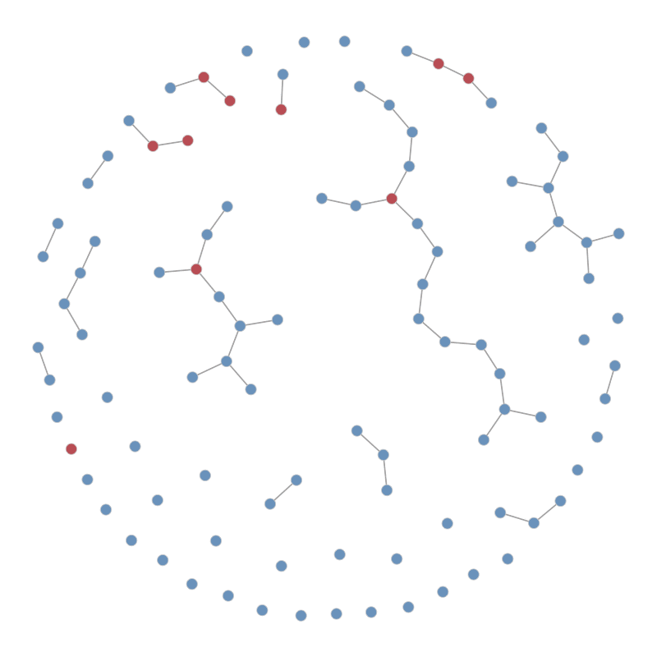
Modeling HIV and STI Transmission in Dynamic Sexual Networks
Temporal exponential random graph models (ERGMs) define partnership formation and dissolution (agent-based, network model)
  Behavioral data from local and national cohorts
  Partnership model terms include:
    Partner type, race, age, sexual role
HIV and STI epidemiology
  Clinical epidemiology and natural history
  Treatment initiation and adherence
  Site-specific transmission dynamics
  NG/CT effect on HIV acquisition/transmission depends on site and sexual role
Notes:
Sexual network types include: main, casual, and one-off partnerships
Likelihood of partnerships forming depends on model terms
Natural history includes: disease stages, viral load, disease-related mortality
Transmission and treatment
Demographic processes

Slide 5
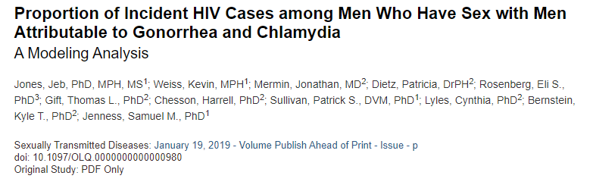
Population attributable fraction (PAF)
PAF is a ‘best estimate’ of the proportion of incident HIV infections due to gonorrhea and chlamydia
Approximately 10.2% (7.9% – 12.4%) of HIV infections among MSM are attributable to NG and CT
  Excess incidence compared to a null model (where STIs have no effect on acquisition or transmission)
Expectation: Averting NG/CT (screening, detection, and treatment) expected to reduce HIV incidence
Jones et al. Sexually Transmitted Diseases 2019.
Notes:
Previous analysis looked at population attributable fraction of STIs on HIV
This built off of our previous modeling work, modeled proportion of incident HIV infections due to NG and CT
Approximately 10% of HIV infections among MSM are attributable to NG and CT
Expectation is that a screening intervention could have an effect on HIV incidence

Slide 6
PAF Modeling Results
Acquisition Analysis (Act-Level)
  As role of STIs increases (higher multipliers):
    Relevant STIs present in a larger proportion of transmission events
    Increased effect of STIs on HIV (greater PAF)
Magnitude of STI effect on HIV acquisition |  | Sites of Sexual Activity with Prevalent STI
 |  | Median (IQR) Proportion of Transmission Events
Rectal | Urethral | STI Present in Transmission Event | PAF
1.97 | 1.48 | 15.8 (14.9, 16.7) | 7.1 (4.6, 9.3)
1.0 | 1.0 | 11.2 (11.1, 12.1) | Referent
1.0 | 3.0 | 14.1 (13.1, 15.0) | 3.2 (0.8, 5.3)
2.0 | 2.0 | 16.7 (15.7, 17.6) | 7.7 (5.9, 9.8)
3.0 | 1.0 | 17.4 (16.7, 18.4) | 9.6 (7.4, 11.9)
3.0 | 3.0 | 21.0 (20.1, 21.8) | 13.8 (11.7, 16.0)
Evaluate a plausible range of multipliers of the effects of STIs on HIV acquisition
Notes:
These data represent site-specific and role-specific effects of STI on HIV acquisition. This table reports proportion of all incident HIV infections.
As STIs were allowed to play a greater role in HIV acquisition and transmission
STIs were present in a greater proportion of transmission events
STIs played a greater role (higher PAF)

Slide 7
STI Control → Effects on HIV?
Used best available data to calibrate model:
  STI and HIV incidence and prevalence statistics
  Prevalence of STI testing in the past 12 months (NHBS)
Modeled the CDC’s STD Screening Recommendations
  At least annual screening for sexually active MSM (NG, CT, syphilis)
  Screen every 3-6 months if at “increased risk”
STI Screening Processes
  Site-specific based on individual sexual role
  Dynamic based on sexual behavior (e.g. lower-risk and higher-risk)
Centers for Disease Control and Prevention. Sexually Transmitted Diseases Treatment Guidelines, 2015.
USPSTF, Bibbons-Domingo K, Grossman DC, Curry SJ, Davidson KW, Epling JW Jr, Garcia FA, Gillman MW, Harper DM, Kemper AR, Krist AH, Kurth AE, Landefeld CS, Mangione CM, Phillips WR, Phipps MG, Pignone MP. Screening for syphilis infection in nonpregnant adults and adolescents: US Preventive Services Task Force Recommendation Statement. JAMA 2016;315(21):2321-2327.²
Notes:
Sexual network types include: main, casual, and one-off partnerships
Likelihood of partnerships forming depends on model terms
Natural history includes: disease stages, viral load, disease-related mortality
Transmission and treatment
Demographic processes

Slide 8
STI Screening Coverage and HIV
STI Screening Coverage
 | Final-Year HIV Incidence Rate | Percent of HIV infections averted (PIA) | STI Screening Tests per HIV infection averted (NNT) | STI PIA
Reference | 1.91 | --- | --- | ---
Sexually Active (SA) Screening Coverage (No Higher-Risk Screening)
10% increase | 1.86 | 0.74% | 150 | 10%
20% increase | 1.83 | 1.35% | 324 | 20%
30% increase | 1.84 | 1.58% | 533 | 32%
40% increase | 1.82 | 1.72% | 593 | 38%
Higher-Risk Screening Coverage (Baseline Annual Screening)
10% | 1.79 | 3.16% | 1775 | 64%
20% | 1.78 | 3.80% | 2528 | 76%
30% | 1.79 | 3.80% | 3071 | 81%
40% | 1.77 | 4.12% | 3395 | 83%
Modeling STI screening over 10 years
Reference model
NHBS levels of annual screening
Limited effect on HIV (PIA)
Much larger effect on STI (PIA)
Low efficiency (NNT)
Solely modeling effect of STIs on HIV acquisition
No enforced correlation of STI and HIV screening
Notes:
Looking at increasing coverage of STI screening among MSM
Minor increase in percent of cumulative HIV infections averted
Larger increase in percent of cumulative STI infections averted
Low efficiency, particularly for higher-risk screening

Slide 9
STI Screening Intervals and HIV
STI Screening Interval
 | Final-Year HIV Incidence Rate | Percent of HIV infections averted (PIA) | STI Screening Tests per HIV infection averted (NNT) | STI PIA
Reference | 1.91 | --- | --- | ---
Annual Screening Interval (Baseline Annual Screening + 5% Higher-Risk Coverage)
6 months | 1.79 | 3.42% | 2304 | 74%
9 months | 1.78 | 2.97% | 1785 | 62%
12 months | 1.80 | 2.33% | 1081 | 50%
15 months | 1.81 | 2.03% | 888 | 40%
18 months | 1.84 | 1.83% | 523 | 29%
Higher-Risk Screening Interval (Baseline Annual Screening + 5% Higher-Risk Coverage)
1 month | 1.80 | 3.44% | 2096 | 61%
3 months | 1.81 | 2.83% | 1417 | 56%
6 months | 1.80 | 2.33% | 1081 | 50%
9 months | 1.82 | 2.63% | 942 | 44%
12 months | 1.83 | 1.67% | 578 | 37%
Solely modeling effect of STIs on HIV acquisition
No enforced correlation of STI and HIV screening
Limited effect on HIV (PIA)
Much larger effect on STI (PIA)
Low efficiency (NNT)
Notes:
Looking at STI screening intervals
Minor increase in percent of cumulative HIV infections averted
Larger increase in percent of cumulative STI infections averted
Low efficiency, particularly for higher-risk screening

Slide 10
Discussion
PAF analysis findings
  STIs are present in a significant proportion of HIV transmission events (STIs may be a good indicator for HIV risk)
  NG and CT have a potentially meaningful effect on HIV incidence among MSM in the United States
STI Screening Guidelines → HIV Incidence
  Limited effect (low PIA) and low efficiency (high NNT) of STI screening on HIV incidence (low PIA)
Why different from 10% value (Jones et al.)?
  Rakai/Mwanza and other STI control trials
  Earlier model was an idealized prevention scenario (cutting effects of STI to null), compared to real-world-effects
  Account for effects of STIs on HIV transmission and acquisition

Slide 11
Next Steps
Given interactions between STIs and HIV, STI prevention and control programs may have a downstream effect on HIV incidence
  Effect may be smaller than expected, but still may be significant
    Assuming 40,000 HIV infections per year for 10 years (400,000 infections), averting 2-4% translates to 8,000 - 16,000 HIV infections
  Sustained programmatic effort to reduce STIs likely required
PIA expected to increase once model allows:
  Enforced correlation of HIV and STI screening (Provider, DIS)
  Effects of STIs on HIV transmission and acquisition
Future work
  Other STI control programs (serostatus-specific screening?)

Slide 12
Acknowledgements
CAMP Public Health Advisory Group
CDC
  OD
  DHAP
  DSTDP
  Jonathan Mermin
  Michelle Van Handel
  Kyle Bernstein
  Harrell Chesson
  Thomas Gift
  Kim Workowski
Emory University
  Emeli Anderson
  Shawnee Anderson
  Samuel Jenness
  Jeb Jones
  Patrick Sullivan
  Monica Trigg
Albany
  Eli Rosenberg
Harvard/UToronto
  Ashleigh Tuite

Slide 13
Appendix

Slide 14
Screening Recommendations:
2015 STD Treatment Guidelines
Screening Recommendations from the 2015 CDC Sexually Transmitted Disease Treatment Guidelines
 | Chlamydia | Gonorrhea | Syphilis
Men who have sex with men (MSM) | At least annually for sexually active MSM at sites of contact (urethra, rectum) regardless of condom use Every 3 to 6 months if at increased risk | At least annually for sexually active MSM at sites of contact (urethra, rectum, pharynx) regardless of condom use Every 3 to 6 months if at increased risk | At least annually for sexually active MSM Every 3 to 6 months if at increased risk
 | Gonorrhea incidence | Chlamydia incidence | HIV prevalence
Target | 4.2 cases/100 person-years | 6.6 cases/100 person-years | 15 cases/100 persons (15%)
Source | Kojima JAIDS 2016 | Kojima JAIDS 2016 | Rosenberg et al. JMIR Public Health Surveill 2016 (National)
 | MSM diagnosed with HIV |  | HIV-negative MSM
 | Tested for gonorrhea in the last year | Tested for chlamydia in the last year | Tested for gonorrhea in the last year | Tested for chlamydia in the last year
Target | 64.1% | 62.8% | 45.8% | 45.8%
Source | NHBS | NHBS | NHBS | NHBS
Centers for Disease Control and Prevention. Sexually Transmitted Diseases Treatment Guidelines, 2015.
USPSTF, Bibbons-Domingo K, Grossman DC, Curry SJ, Davidson KW, Epling JW Jr, Garcia FA, Gillman MW, Harper DM, Kemper AR, Krist AH, Kurth AE, Landefeld CS, Mangione CM, Phillips WR, Phipps MG, Pignone MP. Screening for syphilis infection in nonpregnant adults and adolescents: US Preventive Services Task Force Recommendation Statement. JAMA 2016;315(21):2321-2327.²
Notes:
Guidelines inform clinical practice
Interested in evaluating the impact of getting MSM to test for STIs as recommended?
Are different testing intervals or targeting strategies more effective at identifying and treating infection?
Have to represent certain processes
Screening vs. testing
Rate data (compare to available period prevalence data)
Site-specific infection and testing
Risk categorization
STI and HIV model incidence and prevalence targets from meta-analysis and another estimate
Prevalence of HIV testing from NHBS (serostatus-specific)

Slide 15
Screening and Testing Processes
Tested and Treated (Symptoms-based)
Symptoms
Screened and Treated (Asymptomatic)
Not Tested and Treated
Symptoms-based testing
Rectal symptoms → tested for both rectal NG and CT
Urethral symptoms → tested for both urethral NG and CT
Not Screened and Not Treated
Person with newly acquired STI infection
Site-specific screening
Receptive → tested at rectal site
Insertive → tested at urethral site
Versatile → tested at both sites
Screened and Treated (Asymptomatic)
No symptoms
Not Screened and Not Treated
Sensitivity Analyses: Interval and coverage of screening
Coverage = $\frac{Number on a testing schedule}{Number eligible to be on a testing schedule}=\frac{Number assigned to test annually}{Number sexually active in the last year}$
Notes:
Here is a flowchart for how testing and screening processes are implemented in this model
Green are positive outcomes (testing, screening, treatment)
Imagine a person with newly acquired STI infection
Model parameters govern the likelihood of symptoms (by anatomical site and by STI)
Likelihood of symptoms-based testing, all others can also be screened
STI screening was based on site of sexual activity, STI testing was based on site of symptoms

Slide 16
Screening Indications are Dynamic
Sexually Active MSM - Annual Screening
Higher-Risk MSM - Semiannual Screening
Month 0: Entrance
Month 1: Active with Partner A
Month 2: Active with Partner B
Month 3: Clinical Evaluation
>1 partner in prior 6 months? Yes
≥1 partner in prior 12 months? Yes
Test again in 6 months
Month 9: Clinical Evaluation
>1 partner in prior 6 months? No
≥1 partner in prior 12 months? Yes
Test again in 12 months
Risk Categorization:
Lower-Risk/Sexually Active (SA):
At least one partner in prior 12 months
Higher-Risk (HR):
More than one partner in prior 6 months
Notes:
Higher- and lower-risk categorizations
There is an overlap between those considered “higher-risk” and the “lower-risk” groups
Sample person enters the population, is sexually active, and then clinically evaluated

Slide 17
Limitations to Analysis
Three-STI model
Results contingent on model assumptions
  Epidemiological (HIV prevalence) and network (Atlanta MSM)
Assessed PAF in an acquisition-only model
  Higher PIA expected if accounting for transmission
No enforced correlation of HIV and STI screening
  Additional data required to account for this (commercial)
Assumed 100% rectal screening in receptive and versatile individuals
  Patel STD 2018 – Only 11.6% of MSM were tested for NG or CT extragenitally in the prior 12 months
“Higher-risk” defined by recent number of partners
Notes:
Ongoing work to incorporate syphilis (multi-stage disease progression)
Acknowledging that outcomes are contingent on accuracy of assumptions and model (e.g. HIV and STI prevalence, network structure)
This model was acquisition-only
No correlation enforced for HIV and STI screening -→ future plan
We might expect that uptake of rectal screening (patient and provider) is less than 100%
Other definitions of higher-risk are possible

