Slide 1
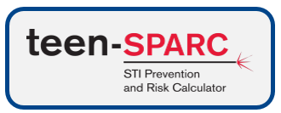
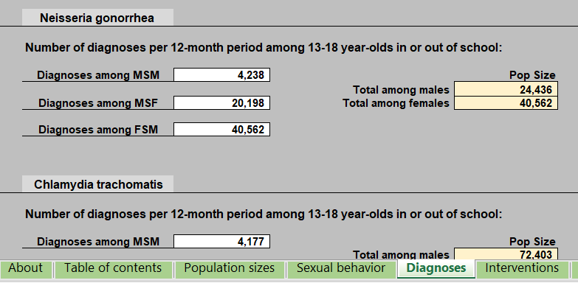
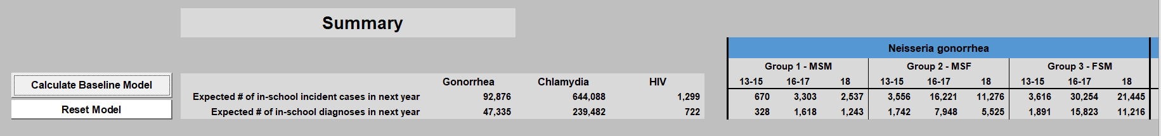
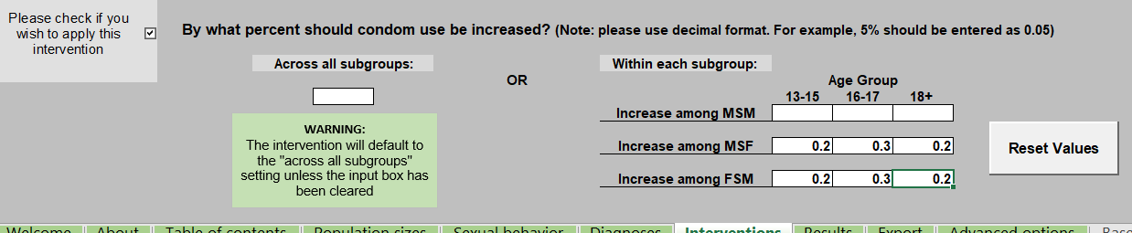
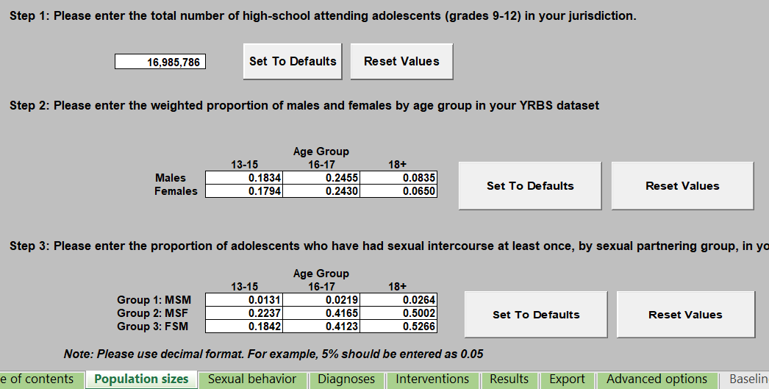
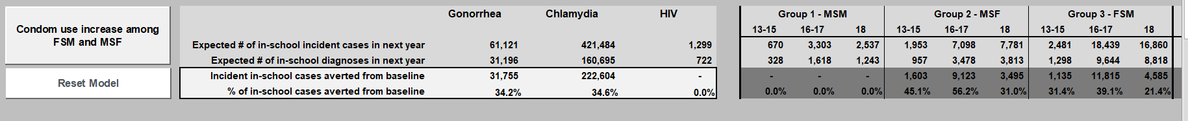
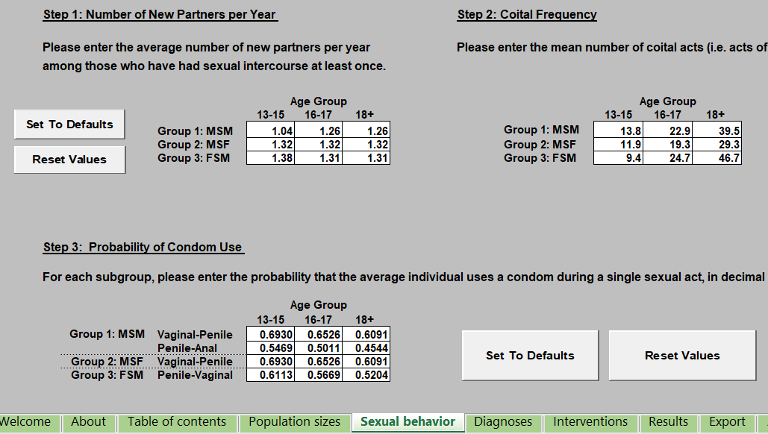
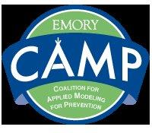



Steven M. Goodreau^{1,2,3*}, Emily D. Pollock^{1,2}, Li Yan Wang⁴, Richard L. Dunville⁴, Lisa C. Barrios⁴,
Maria V. Aslam⁵, Meredith A. Barranco⁶, Elizabeth M. Rosenthal⁶, Eli S. Rosenberg⁶
¹Department of Anthropology, University of Washington, Seattle, WA. ²Center for Studies in Demography and Ecology, University of Washington, Seattle, WA.
³Department of Epidemiology, University of Washington, Seattle, WA. ⁴Division of Adolescent and School Health, Centers for Disease Control and Prevention, Atlanta, GA.
⁵ Program and Performance Improvement Office National Center for HIV, Viral Hepatitis, STD, and TB Prevention, Centers for Disease Control and Prevention, Atlanta, GA.
⁶Department of Epidemiology and Biostatistics, University at Albany School of Public Health, State University of New York, Rensselaer, NY. *Corresponding author: goodreau@uw.edu
A USER-FRIENDLY TOOL FOR HEALTH DEPARTMENTS TO ESTIMATE IMPACTS OF BEHAVIOR CHANGE ON ADOLESCENT STI BURDEN
For up-to-date information on demonstrations of Teen-SPARC at NCSD and beyond, please see:
https://faculty.washington.edu/goodreau/teensparc or email goodreau@uw.edu
Teen-SPARC will be available at http://www.emorycamp.org/teensparc beginning Dec. 2018 [est.]
Background
Inputs and outputs cover 9 subgroups, defined by crossing 3 age groups (13-15, 16-17, 18) with sexual partnering groups:
  MSM: Males who have sex with males
  MSF: Males who have sex with females only
  FSM: Females who have sex with males
3 STIs are modeled: gonorrhea; chlamydia; HIV (for MSM only)
Teen-SPARC is a one-generation Bernoulli model, predicting incident infections and diagnoses in the coming 12 month period
Behavioral changes to explore include:
  Increases in condom use
  Reductions in sexual activity
Teen-SPARC also includes:
  A manual and quick start guide
  A set of default parameters at the national level
Adolescents remain highly impacted by gonorrhea and chlamydia, while HIV rates are rising among adolescent males who have sex with males
Health departments are faced with the challenging task of predicting future STI burden in adolescents, and in deciding on interventions to pursue to reduce that burden
Mathematical modeling can help to predict the near future of infectious disease, and the impact of interventions, given appropriate data and assumptions
Most modeling research uses complex dynamic models, which are ideal for incorporating a wide range of behavioral, biological, clinical and demographic factors together
However, these models are not well suited for broad use by non-specialists in modeling, given their complexity
Simpler models using standardized data sets can help health departments gain insight into their local adolescent STI epidemics, compare them with other jurisdictions, and consider the potential impact of behavioral change of different types on the magnitude of STI burden
Basic structure
# of new diagnoses are predicted for the coming year for each of 9 subgroups, as a function of:
  # of currently uninfected members of the subgroup
  Mean rate of new partner acquisition for the subgroup
  Mean # of coital acts with each partner
  Prevalence of condom use
  Probability each partner is infected with each STI
  Per-act probability of transmission for each STI
Probability each partner is infected is in turn a function of prevalence, estimated from the jurisdiction’s # of recent diagnoses, information about diagnosis rates or proportions, and the duration of infection (for gonorrhea and chlamydia) or observed prevalence/incidence ratio (for HIV)
Teen-SPARC Overview
As part of a CDC/academic collaborative agreement, we have developed a user-friendly Excel tool designed for use by health departments, called Teen-SPARC (STI Prevention and Risk Calculator)
Teen-SPARC uses data from the CDC’s YRBSS (Youth Risk Behavior Surveillance System) as its main source for behavioral inputs. Most states, and many large counties, cities and tribal governments conduct Youth Risk Behavior Surveys
Example using default national data
Proceed through the three data input sheets, each of which is already filled with national default values:
Screenshot from the Diagnoses worksheet
Proceed to Results worksheet for the baseline model:
Introduce behavioral change on Intervention worksheet
Return to Results worksheet:
Screenshot from the Population sizes worksheet
Screenshot from the Sexual behavior worksheet
The Teen-SPARC manual contains detailed instructions and accompanying SAS code that can be used to process YRBS data for any YRBS jurisdiction
This code takes the user from raw YRBS data to Excel output formatted for Teen-SPARC. The only edits needed are to point to local file locations and variable names.
The manual also contains instructions for non-YRBS jurisdictions with local behavioral data
The manual provides detailed instructions about the model assumptions, the derivation of national data, and methods for users to change additional parameters as they wish
Products related to Teen-SPARC in development include (1) a case study paper; (2) a lessons learned paper that explains data challenges for adolescents and STI; and (3) a 10-year extension that estimates impacts of observed race-specific behavior change
NCSD 2018
Funding CDC U38-PS004646
Contact goodreau@uw.edu
This effort was supported by Cooperative Agreement Number 5U38PS004646 by the National Center for HIV, Viral Hepatitis, STD and TB Prevention (NCHHSTP), Centers for Disease Control and Prevention, as part of the NCHHSTP Epidemiologic and Economic Modeling Cooperative Agreement. The findings and conclusions in this report are those of the authors and do not necessarily represent the official position of the CDC.

