Slide 1


Modeling the Cost-effectiveness of Interventions to Eliminate Tuberculosis in Four States
THE 49TH UNION WORLD CONFERENCE ON LUNG HEALTH
24-27 OCTOBER 2018. THE HAGUE, THE NETHERLANDS
October 25, 2018
Youngji Jo
Johns Hopkins Bloomberg School of Public Health
This project was funded by the CDC, National Center for HIV, Viral Hepatitis, STD, and TB Prevention Epidemiologic and Economic Modeling Agreement (NEEMA, # 5U38PS004646-01).
The findings and conclusions in this report are those of the authors and do not necessarily represent the official position of the Centers for Disease Control and Prevention.

Slide 2
Acknowledgements
Johns Hopkins Bloomberg School of Public Health (JHBSPH):
David Dowdy, Sourya Shrestha, Isabella Gomes
Hojoon Sohn, Austin Tucker
US Centers for Disease Control and Prevention (CDC):
Suzanne Marks, Andrew Hill, Garrett Asay
EMORY Coalition for Applied Modeling for Prevention (CAMP)

Slide 3
Background
While tuberculosis (TB) incidence has been declining at a slower rate, elimination targets are not likely to be met without additional efforts.
Reactivation of latent tuberculosis infection (LTBI) accounts for approximately 80% of cases of active TB in the United States.
Targeted testing and treatment for LTBI (TTT) is therefore a cornerstone of the strategy for the elimination of TB disease in the United States.
(Hill et al, 2012)
https://www.acsh.org/news/2018/03/23/more-9000-people-us-got-tuberculosis-last-year-who-were-they-12746

Slide 4
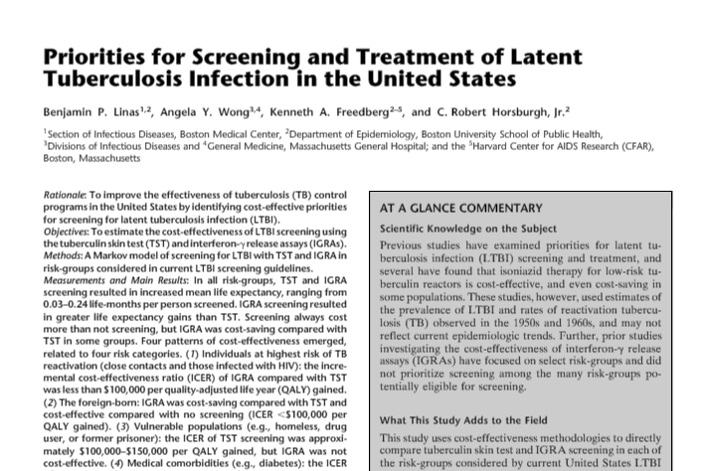
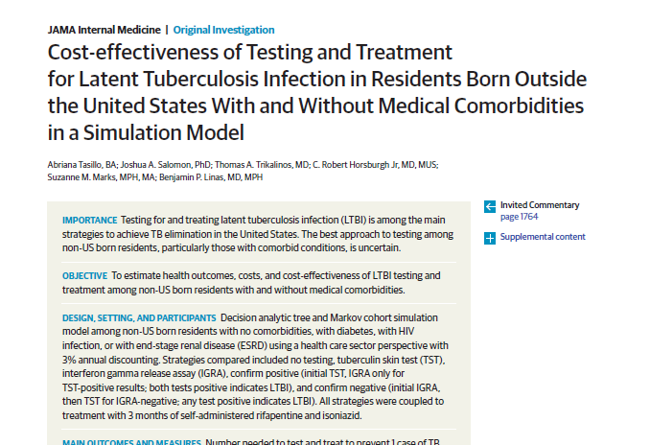
Studies have found that TTT using Interferon Gamma Release Assay (IGRA) testing and either 9 months of isoniazid (INH) or 3 months of INH and rifapentine (3HP) therapy are cost-effective in some populations.
However, impact and cost effectiveness are likely to vary by characteristics of the target population.

Slide 5
Objective
Estimate the cost effectiveness of TTT tailored to key populations
in California, Florida, New York and Texas in the United States
Notes:
For this presentation, we only focused on TTT.

Slide 6
Methods: Effectiveness model
We used a previously developed individual-based TB dynamic modeling framework in four states: California, Florida, New York, and Texas. (Shrestha et al, 2017)
We incorporated five risk populations: (i) non US-born; (ii) diabetic; (iii) HIV-positive; (iv) homeless; and (v) incarcerated.
We estimated the differential population-level impact of two key TB inventions:
  TTT
  Enhanced contact investigation (ECI) - not presented here
Notes:
Based on a state-specific transmission model of TB,

Slide 7
Interventions
Targeted Testing and Treatment (TTT) in 2016
Individuals are screened for TB disease and tested for LTBI, and treated accordingly.
Assumptions:
• Sensitivity of LTBI diagnostic test (IGRA): 85%
• Of LTBI positive, initiation of LTBI treatment: 100%
• Completion of 3 months of self-administered isoniazid & rifapentine (3HP/SAT) : 82%
• Efficacy of LTBI treatment: 93%
Primary epidemiological outcome:
• TB cases averted over 30 years (2016-2045)
Notes:
Mentions about the size of targets among risk groups.
2) Extended Contact Investigation (ECI) : 2016-2025
• % of contacts evaluated: from 82% to 100%
• % of contacts completing LTBI treatment : from 44% to 84%

Slide 8
Approach
Model outputs
Cost
QALY
ICERs
# of individuals tested (2016)
Cost of LTBI and chest radiograph testing (2016)
1
# of individuals LTBI positive (2016)
Cost of LTBI treatment (2016)
QALYs lost (2016)
2
# completing LTBI treatment (2016)
Total cost of Intervention (2016)
3
# of TB cases averted (2016-2045)
Net present value of costs averted
(2016-2045)
QALYs gained
(2016-2045)
Incremental cost
/
Net QALY gained
=
ICERs
Notes:
Spend time to clarify the steps.

Slide 9
Projected yields of TTT in 2016
58%
42%
2%
3%
2%
TTT for 50% of all non-US-born people
Notes:
Major % non usb
Number of people : LTBI positive (%) casecade… visual

Slide 10
Cost inputs and assumptions, 2016$
Cost components | Cost inputs | Reference | CA | FL | NY | TX
Direct Cost of testing | IGRA (QFT-G) | Tasillo, 2017 | $132 | $99 | $126 | $91
 | X-ray (83%, if positive) | Linas, 2008 | $49 | $37 | $47 | $34
Direct Cost of LTBI treatment | 3HP/SAT (Isoniazid & Rifapentine, 3 months) | Shepardson, 2010 | $477 | $357 | $454 | $328
 | Lab monitoring test | Holland, 2008 | $236 | $177 | $225 | $162
 | Toxicity without hospitalization (8.3%) | Shepardson, 2010 | $247 | $185 | $235 | $170
 | Toxicity with hospitalization (0.015%) | Holland, 2008 | $7,927 | $5,942 | $7,547 | $5,451
Direct Cost per TB illness | Medical cost | Castro, 2016 | $23,236 | $17,419 | $22,123 | $15,979
+ Cost adjustment: GDP deflator (2016, USD) & Cost of living adjustment index (CA 1.33, FL: 0.99, NY: 1.26, TX: 0.91)
Notes:
Table footnote just mention adjustment

Slide 11
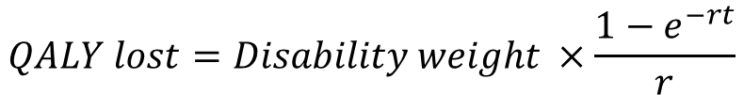
QALY assumptions
QALYs lost during LTBI treatment (2016)
LTBI treatment duration : 3 months
Disability weight
  LTBI treatment: 0
  LTBI treatment toxicity (8.2%): 0.25
  Hospitalization (7 days) (0.015%): 0.5
Mean QALY lost per LTBI treatment: 0.005
X # of individuals who complete LTBI treatment (2016) = Total QALYs lost
$$QALY lost=Disability weight ×\frac{1−e^{−rt}}{r}$$
Where r = discount rate (3% per year ), t = treatment duration (3 months)

Slide 12
QALY assumptions
QALYs gained by averting TB cases (2016-2045)
1) QALYs gained per TB case averted: 0.14
2) QALYs with remaining life with existing condition (Case fatality TB 5%, TB&HIV 9%):
  Disability weight (Non USB, Homeless, Incarcerated : 0, Diabetes: 0.165, HIV positive: 0.06)
  Age at TB diseases: Non USB: 45~51, Diabetes, 56~61, HIV: 42~45, Homeless: 47~49, Incarcerated: 38~41
  Remaining life years, capped at 30: Non USB: 26~35 across states, Diabetes: 6~10, HIV : 28~33 Homeless: 30~34, Incarcerated: 38~41
Risk groups (e.g. California) | #TB cases averted (2016-2045) | # QALYs gained per TB case averted | Total # QALYs gained (2016-2045) with discount rate 3%
Non US born | 9,802 | 1.12 | 8,218
Diabetic | 3,585 | 0.36 | 992
HIV-positive | 669 | 1.73 | 951
Homeless | 523 | 1.18 | 497
Incarcerated | 244 | 1.31 | 276

Slide 13
Direct Cost of TTT (2016$)
$1.3B
37%
$700M
$463M
63%
$295M
$250M
$341M
$300M
$288M
$35M
$108M
$53M
$18M
$28M
$20M
$31M
$50M
$17M
$13M
$17M
$37M
50% of Non US Born, 80% of people with diabetes, 100% of others
Notes:
Not to say resource allocation decision such as we have to spend more money for treatment than testing. As a result based on model output

Slide 14
For California, Costs of TTT in 2016, and Net Present Value of TB Disease Costs Averted (2016-2045) Across Risk Populations
$1.3B
$700M
$280M
$96M
$35M
$108M
$35M
$19M
$12M
$8M
Notes:
Cost saving
Not of
Net cost 화살표

Slide 15
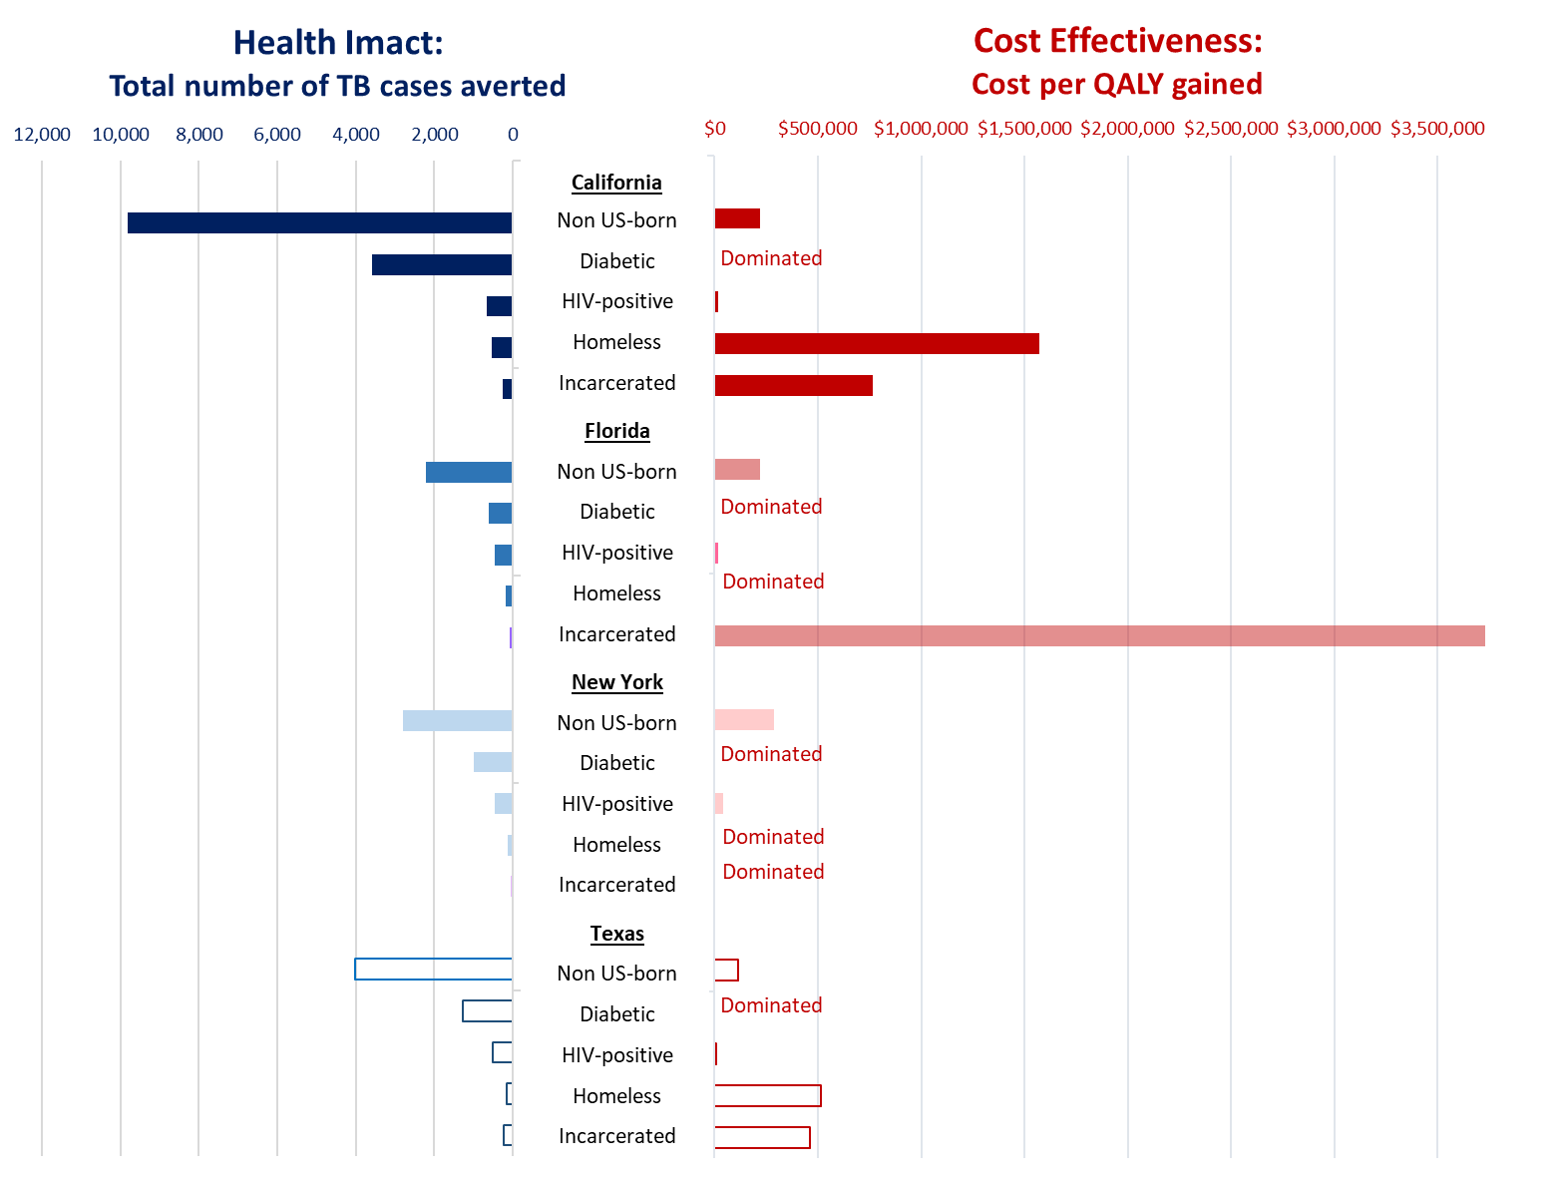
ICERs: Net Present Value of Costs per QALY gained through TTT (2016-2045)
Greater health impact
Less cost effective
$100,000
TTT among Non US born is likely cost effective.
TTT among People Living with Diabetes is the least cost-effective intervention due to greater QALY lost (older age of TB disease onset, short remaining life time, high disability weight)
TTT among People Living with HIV is the most cost effective intervention in each state due to greater QALY gained (younger age of TB disease onset, high case fatality rate, lower disability weight) and high LTBI prevalence and risk of TB reactivation.
Cost effectiveness is sensitive to assumptions about toxicity - Assuming 0.5% toxicity, ICER for treating non US born drops about half from $222K to $121K. (Similar affect to other groups)
$222K
$222K
$287K
$112K
Notes:
Homeless and Incarcerated show similar ICERs patterns like Non USB across stages.
All intervention show overall high ICERs: CA 3M, FL 2M, TX 550K per QALY gained.
Cost per only QALY gained shows about 200K-350K per QALY gained across the states.

Slide 16
Conclusions
ICERs differ across risk populations and states, ordered from most to least cost effective:
  HIV-positive
  Non-US-born
  Homeless
  Incarcerated
  Diabetic
Implications:
  While conducting TTT in populations with greatest cost effectiveness makes good use of program dollars, TTT among the non-US-born population is needed to make substantive progress towards TB elimination.
  We may need to more closely target individuals who are non-US born and living with diabetes to optimize the cost-effectiveness of TTT.
  Research on better ways to target the LTBI population at risk for reactivation would help reduce program cost and increase cost-effectiveness.
Note: These results are preliminary and subject to change.
Notes:
→ Some key populations (e.g., people living with diabetes) may experience less benefit from LTBI treatment (due to older age = higher toxicity and lower life expectancy; also comorbidity reducing quality of future life).

Slide 17
Limitations
Our costs only include the healthcare system costs of testing and treatment, and exclude program implementation costs (recruiting, initial screening etc.) or patient costs or other societal costs.
State population was based on the fixed number for 2016, and does not include annual growth for cost and QALY calculations.
The model considers an open cohort of the full population of each state but does not consider lifetime of the cohort that received the intervention.
We only considered those who completed LTBI treatment, not those who initiated but did not complete treatment. (if so, treatment cost may be more expensive)
Our disability weight to the existing condition were mainly given to health related morbidities such as HIV and diabetes (assuming 0 disability weight to Non USB, incarcerated, homeless)
We did not account for differences within the non-US-born population (timing of arrival, origin of country, age, other comorbidities).
We assumed a standard testing (IGRA) and treatment (3HP) protocol across risk groups and states.
Notes:
Efficacy efficiency: targeting, completion, risk of progression

Slide 18
Next steps
Model, Cost, and ICER comparisons for California as a reference case among the collaborators
Sensitivity analyses (one-way/multi-way/probabilistic) to evaluate the importance of different model parameters (e.g., LTBI prevalence, treatment completion, diagnostic sensitivity, TB reactivation rate, costs of testing/treatment, discounting rate, QALY loss etc.)
Probabilistic sensitivity analyses to see how the probability of cost effectiveness may vary and compare to budget constraints/capacity to target key populations in each state.
Notes:
Cost effectiveness acceptability curves to see how cost effectiveness may differ by budget constraints to respective risk groups in each state

Slide 19
Thank you!
Any comments & questions?
yjo5@jhu.edu

