Slide 1





Modeling the joint effects of PrEP for adult MSM and adolescent sexual minority males in the U.S.
D. T. Hamilton, MPH PhD, S. M. Goodreau, PhD, S. M. Jenness, PhD, P. S. Sullivan, DVM PhD, L. Wang, MBA MA, R. L. Dunville, MPH, L. C. Barrios, DrPH, M. Aslam, PhD, E. S. Rosenberg, PhD
2019 National HIV Prevention Conference
Mar 18 - 21, 2019, Atlanta, Georgia, USA

Slide 2
Background
Adolescent sexual minority males (ASMM) are at high risk for HIV acquisition
CDC surveillance indicates >1300 new HIV diagnoses/year among ASMM (ages 15-19) whose primary risk category is sexual contact with another male
  Rates of HIV testing are low
  Incidence and prevalence are likely much higher
Prevalence estimates among 18–22 year-old MSM were 11-14% across three National HIV Behavioral Surveillance rounds
Targeting interventions exclusively towards adults may be too late

Slide 3
Motivation
The potential impact of PrEP use on the HIV epidemics among MSM and ASMM has been evaluated in several modeling studies
    Jenness et al. 2016 “Impact of the Centers for Disease Control's HIV Preexposure Prophylaxis Guidelines for Men Who Have Sex With Men in the United States.” J Infect Dis. 2016.
    Jenness et al. 2017 “Incidence of gonorrhea and chlamydia following human immunodeficiency virus preexposure prophylaxis among men who have sex with men: a modeling study.” Clinical Infectious Diseases 65 (5), 712-718. 2017
    Jenness et al. 2017 “Individual HIV risk versus population impact of risk compensation after HIV preexposure prophylaxis initiation among men who have sex with men.” PloS one 12 (1), e0169484 2017
    Goodreau et al. 2018 “Targeting Human Immunodeficiency Virus Pre-Exposure Prophylaxis to Adolescent Sexual Minority Males in Higher Prevalence Areas of the United States: A Modeling Study.” Journal of Adolescent Health 62 (3), 311-319. 2018
    Hamilton et al. 2018 “Potential Impact of HIV Preexposure Prophylaxis Among Black and White Adolescent Sexual Minority Males.” AJPH Supplement 4, 2018, Vol 108, No. S4
These populations are not independent
When modeling populations in isolation potentially important effects can be missed

Slide 4
Goal
Our goal with this study it to estimate the population level impact of PrEP interventions among adult MSM and ASMM

Slide 5
The model
Agent based stochastic network model
  Built on the EpiModel platform http://www.epimodel.org/
    Tools for simulating and analyzing mathematical models of infectious disease dynamic
Three age groups
  Older adult MSM (OAMSM) – ages 26-40
  Young adult MSM (YAMSM) – ages 19-25
  Adolescent sexual minority males (ASMM) – ages 13-18
Four relationship types
  Main – long term partnerships between two adult MSM
  Persistent – shorter term partnership between two adult MSM
  Onetime – single event partnership between two adult MSM
  ASMM – relationships between two ASMM or an ASMM and a YAMSM

Slide 6
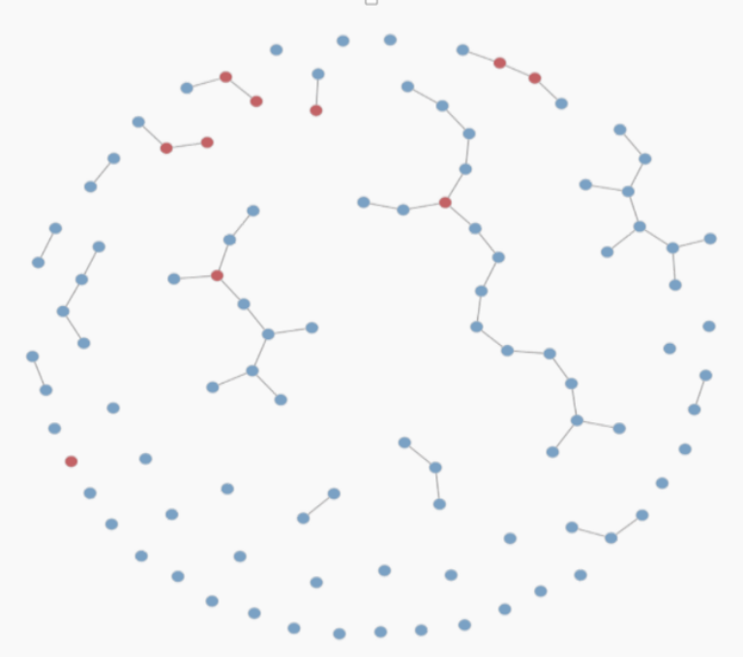
Key components of the model framework
Dynamic Partnership Network
HIV Transmission:
Care Engagement:
Behavior
Coital Frequency
Condom Use
Role
Behavior
Testing
PrEP
ART
Infectivity
Stage (viral load)
CC engagement
Demographics: Entry
Aging
+
Transmission
Dynamics
Exit

Slide 7
Entry and debut
Births / Entry
All actors enter at age 13
At entry actors are assigned an age to self-identify as ASMM
Only actors that have self-identified as ASMM are eligible to debut
All actors are self-identified ASMM and debuted at age 19
Age 13
Identify as ASMM
.44
.10
.10
.13
.12
.11
13
14
15
16
17
18
.506
Debuted
Not Debuted
.003
Debuted

Slide 8
Simulations
Population
  ~13,500 13–39-year-olds (500 per 1-year age)
Baseline Epidemic
  ~7% overall HIV prevalence among sexually-active 18-year-old ASMM
  ~28.3% prevalence among adult MSM
Time Horizon
  10 years
Replicates
  100 simulations / intervention scenario

Slide 9
PrEP Interventions
 | Baseline Counterfactual: No PrEP | PrEP for adult MSM only | PrEP for adult MSM and ASMM | PrEP for adult MSM and ASMM | PrEP for adult MSM and ASMM
PrEP coverage for adults | NA | 40%
PreP adherence for adults | NA | 21.1% No measurable adherence 7.0% low (<2 pills/week) 10.0% medium (2-3 pills/week) 61.9% high (4+ pills/week)
PrEP coverage for ASMM | NA | NA | 10% | 20% | 30%
PreP adherence for ASMM | NA | NA | 20.9% No measurable adherence 24.4% low (<2 pills/week) 13.1% medium (2-3 pills/week) 41.6% high (4+ pills/week)

Slide 10
Results over 10 years of simulation
Outcome | PrEP coverage: adult MSM / ASMM
 | Baseline Counterfactual 0% / 0% | Adults only Intervention 40% / 0% | Adult and ASMM PrEP interventions 40% / 30%
Percent of infections averted (Mean and 95% Credible Interval) | NA | 29.0% (24.0%, 34.4%) | 29.9% (23.6%, 35.0%)
Number of infections averted per 100K person years at risk (Mean and 95% Credible Interval) | NA | 693 (574, 830) | 716 (558, 842)
Number needed to treat to avert a single infection (Mean and 95% Credible Interval | NA | 33 (27, 40) | 34 (29, 43)
Prevalence (population) | 23.2 (21.4, 24.5) | 17.0 (15.7, 18.0) | 16.8 (15.4, 17.9)
Prevalence among 18 year-olds | 6.0 (4.0, 8.3) | 4.3 (2.3, 6.5) | 3.8 (2.0, 6.0)
Incidence per 10k person years | 322.7 (292.8, 344.2) | 206.4 (187.4, 220.7) | 202.9 (185.7, 217.6)

Slide 13
Conclusions
PrEP use by adult MSM and ASMM can significantly reduce HIV incidence in these populations averting ~ 30% of infections over 10 years
  Our findings support those of previous studies that have looked at these populations individually
PrEP use by adult MSM can significantly reduce the number of infections among ASMM by reducing HIV exposure among ASMM who partner with adult MSM
PrEP programs targeting ASMM will not have a large impact on the overall HIV epidemic because ASMM represent a small at risk population
  PrEP programs targeting ASMM can have a significant impact of incidence among ASMM even in the context of broader PrEP programs for adults reducing HIV incidence by 12%
Modeling populations in isolation can miss important interactions
  When possible interacting populations should be modeled together

Slide 14
THANK YOU
This research was funded by US Centers for Disease Control and Prevention National Center for HIV, Viral Hepatitis, STD, and TB Prevention (Epidemiologic and Economic Modeling Agreement number 6NU38PS004646). The findings and conclusions in this report are those of the authors and do not necessarily represent the official position of the Centers for Disease Control and Prevention.

Slide 15
Models of adult MSM may overestimate the impact of adult PrEP on MSM
Two simplifying assumptions
  Entrants into the population are all HIV-negative
  HIV prevalence in the simulation should match the empirical prevalence of the adult population being modeled
  Bias – Transmission within the adult model may be too high
    Incident cases must occur to account for what should be prevalent cases aging into the population.
    In a PrEP intervention scenario the “extra” incident cases could be averted by PrEP

Slide 16
PrEP use by adults may reduce incidence in younger age cohorts
Some fraction of HIV infections among adolescents results from sexual contact with young adults
      Whiteside et al. 2015 “Molecular analysis allows inference into HIV transmission among young men who have sex with men in the United States.” AIDS. 2015;29(18):2517-22. PubMed PMID: 26558547; PMCID: PMC4862399.
      Wolf et al. 2017 “Short Communication: Phylogenetic Evidence of HIV-1 Transmission Between Adult and Adolescent Men Who Have Sex with Men.” AIDS Res Hum Retroviruses. 2017;33(4):318-22. PubMed PMID: 27762596; PMCID: PMC5372772.
If PrEP use among all adults reduces prevalence among young adults who may partner with an adolescent, incidence among adolescents may decline

Slide 17
ASMM PrEP may reduce HIV incidence and prevalence among adult MSM
Young adult MSM may acquire an infection directly from ASMM via sexual contact.
ASMM who are HIV positive age into the young adult MSM population.
Reduced prevalence among ASMM because of ASMM PrEP will reduce both of these pathways leading to reduced HIV incidence and prevalence among adult MSM.

Slide 18
Models of ASMM PrEP may underestimate the impact of PrEP on ASMM
ASMM may acquire an infection via contact with a young adult
  Prior models of ASMM have captured this risk via a constant force of infection
As ASMM PrEP reduces incidence among ASMM
  1) prevalence among those aging into adulthood should decline
  2) prevalence in the pool of young adult partners of ASMM declines

Slide 19
Models of ASMM PrEP may overestimate the impact of PrEP on ASMM
ASMM PrEP may only delay some infections into adulthood rather than averting them
Delayed infections may be misclassified as averted

Slide 20
Results over 40 Years of simulation
Outcome | PrEP coverage: adult MSM / ASMM
 | 0% / 0% | 40% / 0% | 40% / 30%
Prevalence (population) | 22.2 (20.1, 24.0) | 7.4 (6.0, 8.5) | 6.9 (5.5, 7.9)
Prevalence among 18 year-olds | 6.7 (3.9, 9.1) | 2.1 (0.4, 4.0) | 1.5 (0.4, 3.0)
Incidence per 10k person years | 311.9 (288.4, 328.1) | 133.1 (117.7, 145.7) | 127.9 (113.7, 140.0)
Person years HIV+ per 10K person years | 2557 (2401, 2691) | 1481 (1343, 1582) | 1445 (1327, 1542)
Average age at infection (over years 35-39) | 26.1 (s.d.=6.3) | 27.0 (s.d.=6.8) | 27.3 (s.d.=6.7)

