Slide 1



Prevalence of Chronic Hepatitis C Virus Infection
US States and District of Columbia, 2013-2016
Eli Rosenberg, PhD, Associate Professor
Department of Epidemiology and Biostatistics
University at Albany School of Public Health, SUNY

Slide 2
Outline
Background on HCV prevalence estimation
Overview of methodology
Results
Limitations and strengths
Conclusions

Slide 3
Background on HCV Prevalence Estimation
State-level burden of HCV infection informs policies, resource allocation, advocacy, and elimination efforts
Prevalence of current infection (RNA)
  Measured in nationally representative residential survey:
  National Health and Nutrition Examination Survey (NHANES)
  In most states challenging to measure directly from diagnoses reported to surveillance
Statistical models allow combining national NHANES HCV prevalence with local information to yield state-level results
    National Vital Statistics System (NVSS) mortality
    American Community Survey (ACS) population sizes

Slide 4
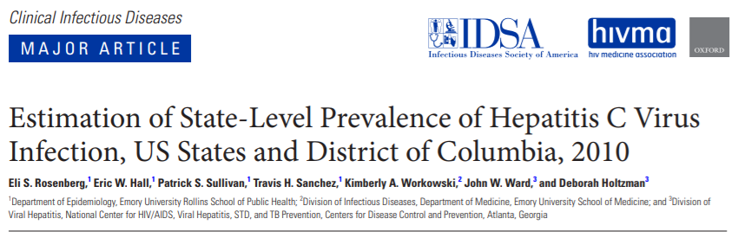
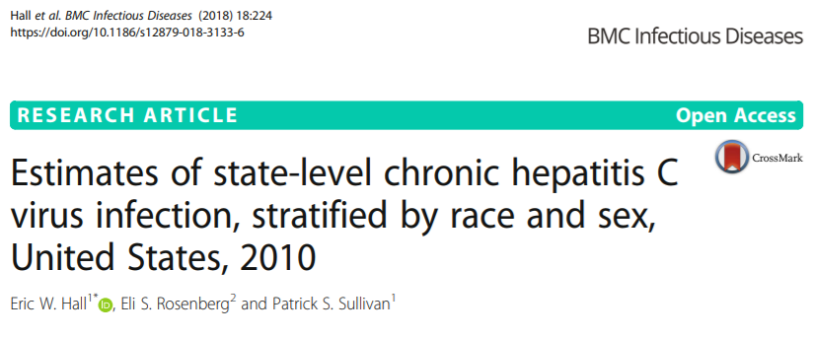
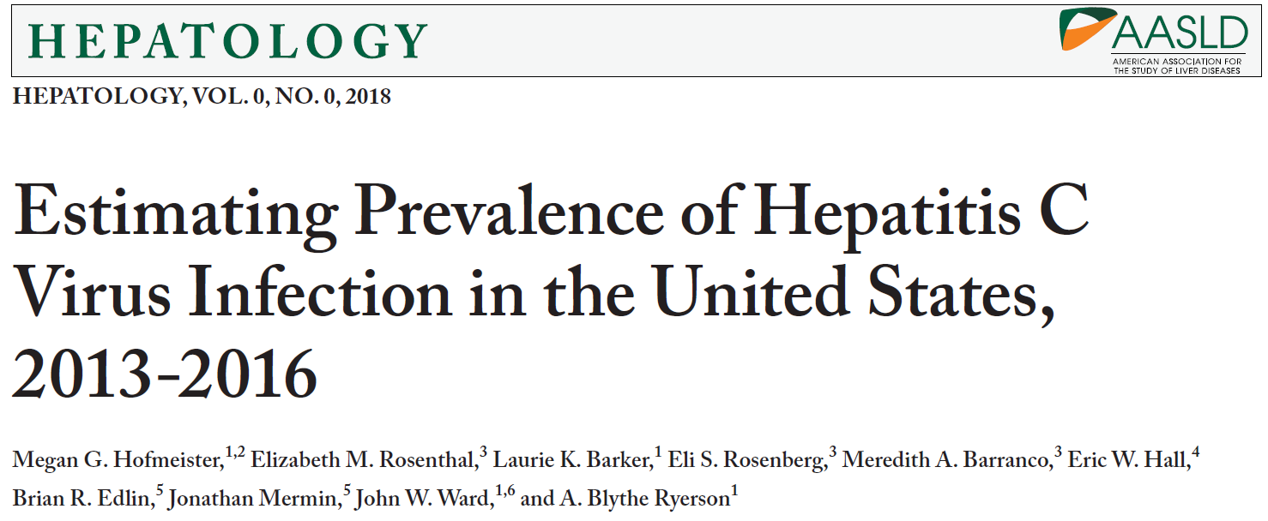
Method builds on previous approaches for national, state estimates
Notes:
This work builds on a series of analyses conducted with colleagues at CDC Division of Viral Hepatitis and Emory University to estimate state-level level prevalence in 2010, overall and by sex/race groups. We most recently published an update to HCV prevalence nationally, published in Hepatology last week. That analysis serves as a jumping-off point for this state-level work, building on the previously-published state-level methods.

Slide 5
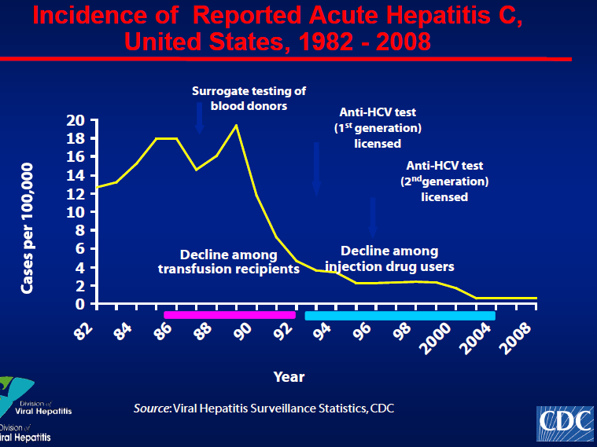
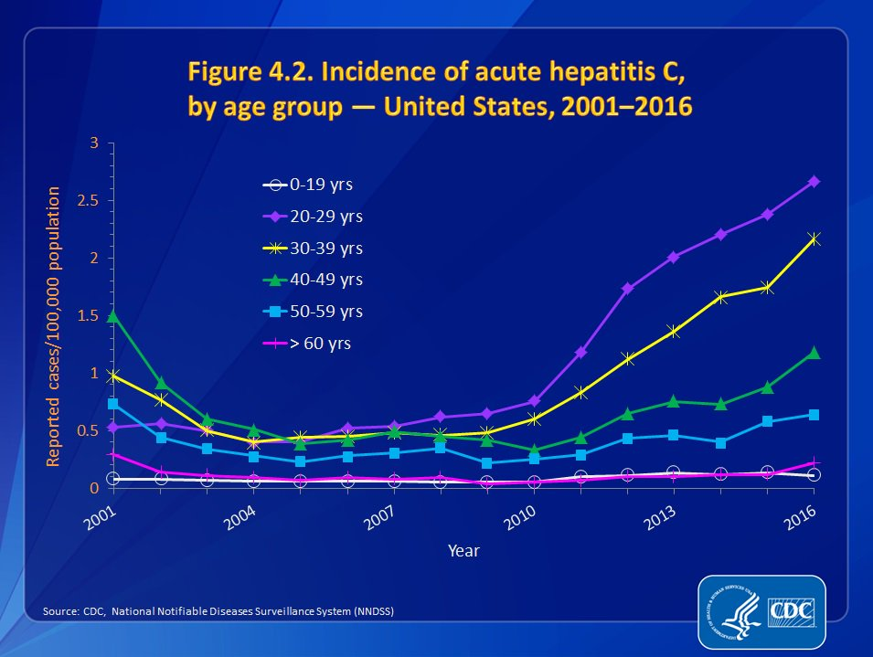
Shifting epidemiology of HCV to account for
Effect on HCV prevalence
Rapid rise in incidence in younger PWID due to opioid epidemic
Mortality in high prevalence group: 1945-1965 birth cohort
Scale-up of cure via DAAs

Slide 6
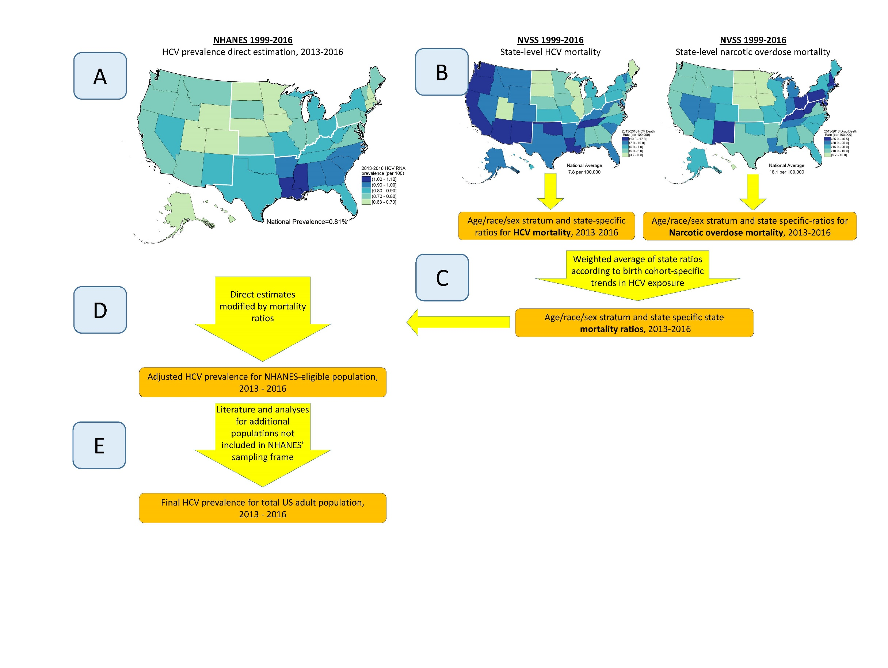
Overview of analytic approach
1

Slide 7
Overview of analytic approach
1
2

Slide 8
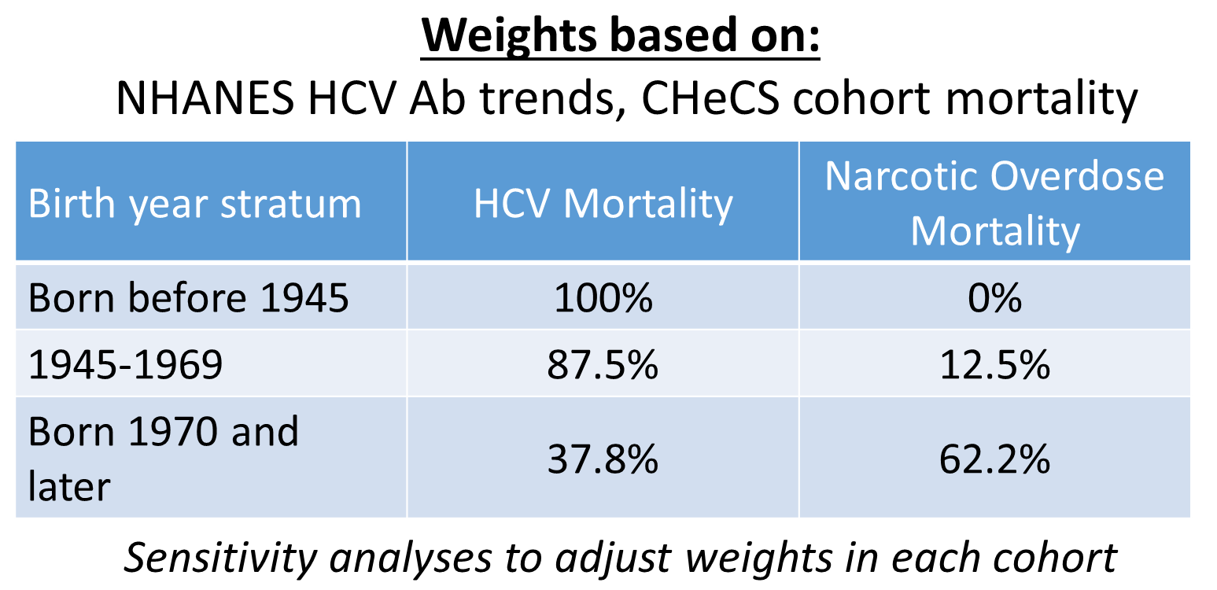
Overview of analytic approach
1
2
3

Slide 9
Overview of analytic approach
1
2
3

Slide 10
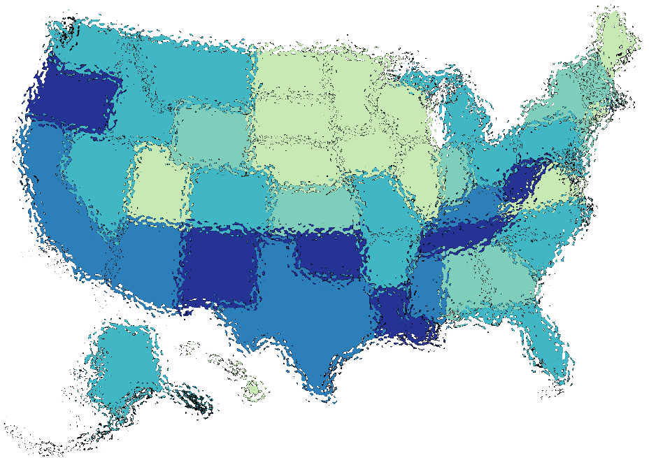
Overview of analytic approach
1
2
4
3

Slide 11
Overview of analytic approach
1
2
4
3
5

Slide 12
Data sources for steps 1-4
Data source | Years | Purpose | Number of individuals represented | Number of cases
National Health and Nutrition Examination Survey (NHANES) | 1999-2016 | National HCV RNA prevalence overall and by strata of sex, race/ethnicity, birth cohort and poverty. Trends in anti-HCV inform analysis weights. | 47,387 with non-missing HCV RNA test results 47,590 with non-missing anti-HCV test results | 575 with positive HCV RNA test 874 with positive anti-HCV test
U.S. Census intercensal data | 1999-2016 | Population structure for modeling HCV- and overdose-related mortality rates. | 4,109,869,228 person-years age 18 or above | n/a
U.S. Census American Community Survey (ACS) | 2012-2016 | Noninstitutionalized United States population structure for final estimates. | 12,023,450 observations of noninstitutionalized persons aged 18 or above | n/a
National Vital Statistics System (NVSS) | 1999-2016 | Distribution of Hepatitis C-related mortality, signaling underlying HCV prevalence, to inform distribution of older HCV infections. | 44,071,310 decedents age 18 or above who resided in the 50 states or Washington DC | 261,858 with HCV as underlying or multiple cause of death
National Vital Statistics System (NVSS) | 1999-2016 | Distribution of narcotic overdose mortality, signaling underlying injection patterns, to inform distribution of newer HCV infections. | 44,071,310 decedents age 18 or above who resided in the 50 states or Washington DC | 541,130 with unintentional or undetermined cause narcotic or unknown drug as cause of death

Slide 13
Populations not Included in NHANES (step 5)
Residents of nursing homes
Unsheltered homeless
Incarcerated
Approach
  State-level population size estimates for each population
  Estimate HCV prevalence in each population
    Residents of nursing homes
      Used on NHANES sex/age-specific prevalences
    Unsheltered homeless, incarcerated
      Review of articles published 1/1/2013 to 12/31/2017
  Two alternative methods for combining
    Multiply population sizes by national HCV estimate in each population
    Further adjustment for underlying state’s general population prevalence

Slide 14
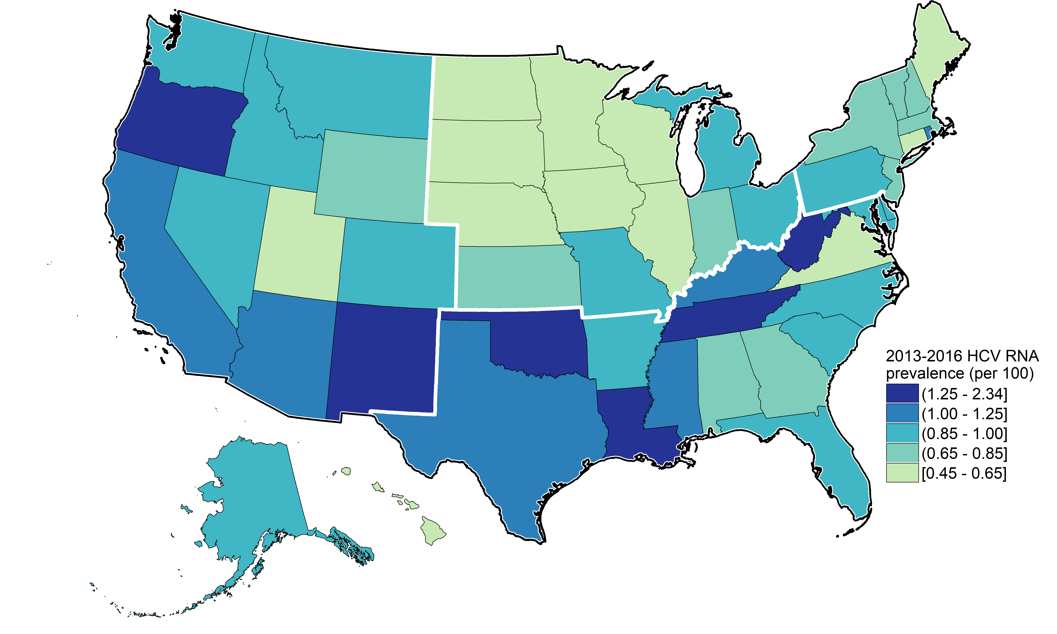
Results: HCV RNA Prevalence, 2013-2016
Appalachia
3/10 highest prevalence states
West
10/13 states have prevalence above median
Notes:
Range of states: 0.45 to 2.34
Median 0.88%
Appalachia – in 2010, TN was only Appalachian State with highest prevalence, now seeing emergence of WV and KY
Range of 0.45-2.34 per 100

Slide 15
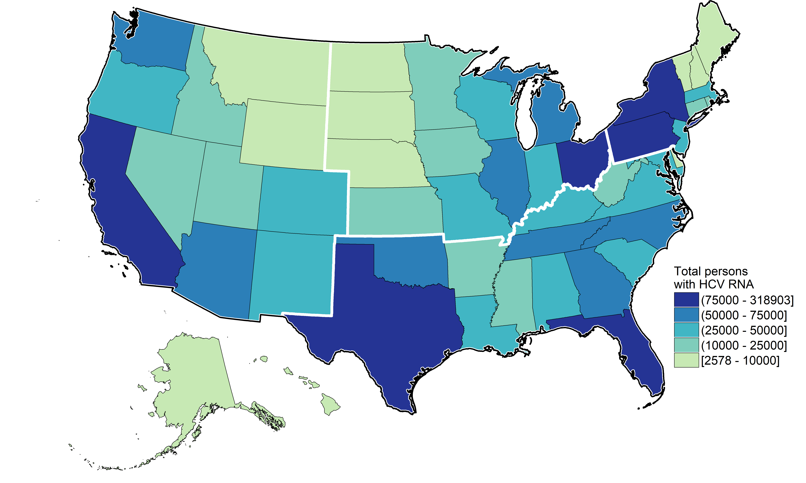
Results: Persons with HCV RNA, 2013-2016
9 states comprise of 52% of all persons with HCV
Appalachia
5/10 states with highest number of infections
TN and AZ only states in top 10 prevalence and persons with HCV
Notes:
Distinguish between high rate and high population: OH, PN, NY have moderately high rates, but because of high population, have some of the highest number of infections
Reflects population size

Slide 16
Limitations & Strengths
Limitations to consider
  NHANES representation of HCV increases among PWID
  HCV- & opioid- mortality incomplete proxies for underlying HCV infection
  Estimates represent average during 2013-2016
    Period of rising incidence
    Likely increasing >2016
Strengths of approach
  Synthesis of large national datasets, with local information
  Few model assumptions
  Allows apples-apples comparisons between states

Slide 17
Conclusions
National surveys, in conjunction with local mortality data that capture multiple aspects of HCV epidemics, enable systematic estimation of state-level HCV prevalence
Highest rates frequently in states:
  deeply affected by opioid crisis
  with history of increased levels of injection drug use, chronic HCV infection
States can use estimates to benchmark epidemic and guide prevention, diagnosis, and treatment efforts

Slide 18
Thank you!
Eli Rosenberg erosenberg2@albany.edu
UAlbany:
Katie Tote, Elizabeth Rosenthal, Meredith Barranco
Emory University:
Eric Hall, Patrick Sullivan
CDC DVH:
Blythe Ryerson, Jono Mermin, Patricia Dietz, Megan Hofmeister, Laurie Barker
Work supported by:
CDC 5U38PS004646: CDC National Center for HIV/AIDS, Viral Hepatitis, STD, and TB Prevention Epidemic and Economic Modeling Agreement (NEEMA)

Slide 19
Extra slides

Slide 20
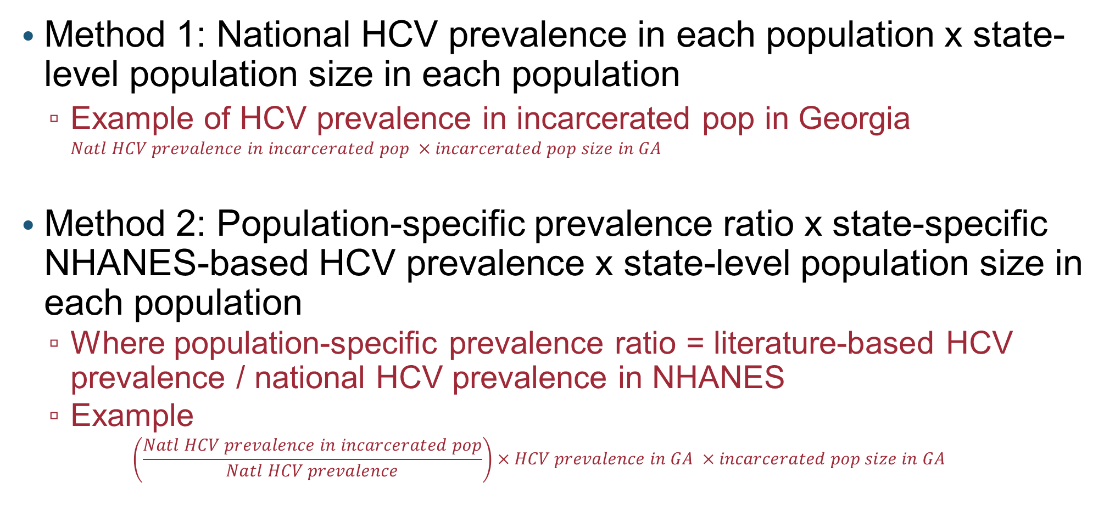
Approaches for unsampled populations
Method 1: National HCV prevalence in each population x state-level population size in each population
  Example of HCV prevalence in incarcerated pop in Georgia $Natl HCV prevalence in incarcerated pop ×incarcerated pop size in GA$
Method 2: Population-specific prevalence ratio x state-specific NHANES-based HCV prevalence x state-level population size in each population
  Where population-specific prevalence ratio = literature-based HCV prevalence / national HCV prevalence in NHANES
  Example
  $$\left(\frac{Natl HCV prevalence in incarcerated pop}{Natl HCV prevalence}\right)×HCV prevalence in GA ×incarcerated pop size in GA$$

Slide 21
Example: Incarcerated
Prevalence estimate:
  Literature review HCV Ab and RNA prevalence
  Random-effects meta-analysis (7 studies)
  10.7% (95%CI: 9.5%-12.0%) RNA prevalence
    Matches recent review by Spaulding et al. Infect Dis Clin North Am. 2018
Population sizes:
  Bureau of Justice Statistics Correctional Population, 2016

Slide 22
National Estimates
National NHANES 2013-2016 vs. estimates from late 2000’s
(Hofmeister et al, Hepatology 2018)
  -11% change in Ab prevalence
  -20% change in RNA prevalence
Prevalence trends reflect incidence, mortality, cure

Slide 23
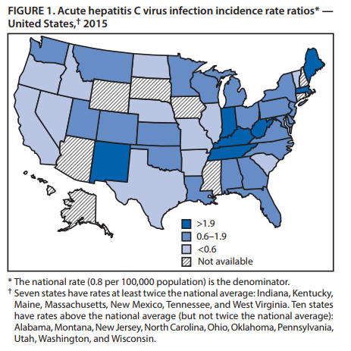
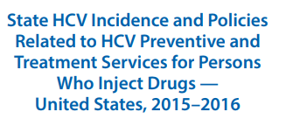
Acute HCV reports (NNDSS)
MMWR, vol 66, no 18, May 12, 2017

Slide 24
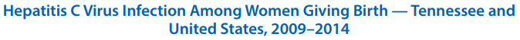
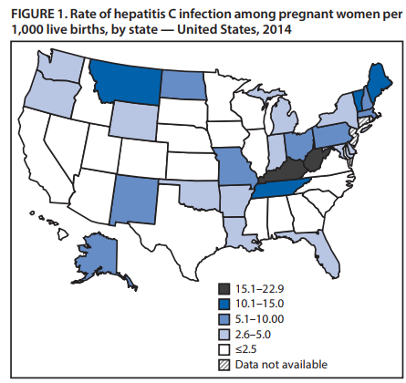
Maternal HCV on birth certificiates (NVSS)
MMWR, vol 66, no 18, May 12, 2017

Slide 25
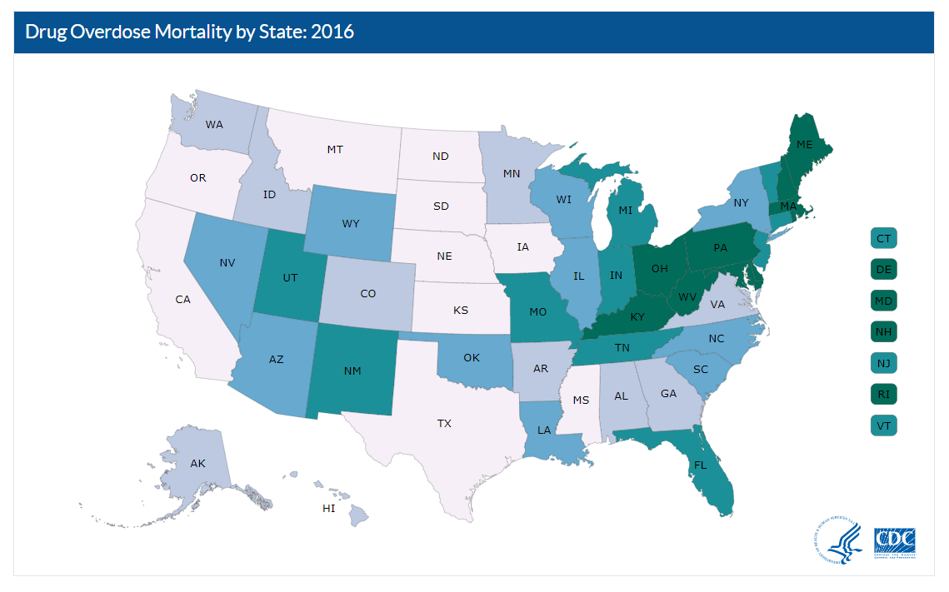
Drug overdose mortality
https://www.cdc.gov/nchs/pressroom/sosmap/drug_poisoning_mortality/drug_poisoning.htm

Slide 26
Definition of overdose death
Level 1
Overdose deaths by drug class by state
Overdose deaths by specific drugs by state
Level 4 (Ideal)
Overdose deaths by state
Level 3
Overdose deaths by specific drugs and injection by state
Level 2
Injection-specific drug use death would be ideal
  Not a specific ICD-10 code
  Not consistently recorded in open-text

Slide 27
Definition of overdose death
Level 1
Overdose deaths by drug class by state
Overdose deaths by specific drugs by state
Level 4 (Ideal)
Overdose deaths by state
Level 3
Overdose deaths by specific drugs and injection by state
Level 2
Drug poisoning ICD-10 codes are classified into four categories of intentionality
  unintentional (X40-44)
  suicide (X60-64)
  homicide (X65)
  undetermined intent (Y10-14)
Included
Included
Notes:
We included overdoses of undetermined intent to increase the sensitivity of our definition because it would include accidental and non-accidental overdoses without sufficient information to record otherwise.
We did not include drug deaths coded as suicides because the proportion of drug deaths coded as suicides does not vary much between states. Additionally, drug intoxication is not the majority of suicide deaths.

Slide 28
Definition of overdose death
Level 1
Overdose deaths by drug class by state
Overdose deaths by specific drugs by state
Level 4 (Ideal)
Overdose deaths by state
Level 3
Overdose deaths by specific drugs and injection by state
Level 2
Within each category of intentionality, ICD-10 codes are classified into drug class
  non-opioid analgesics
  antiepileptic, sedative-hypnotic, psychotropic, etc.
  narcotics and hallucinogens (X42, Y12)
  drugs acting on the autonomic nervous system
  other unspecified drugs (X44, Y14)
Included
Included
Notes:
Narcotics includes drugs administered by injection and other routes of administration. We included this definition because it is more specific than using all drugs.
The process by which death investigations and drug toxicology is performed differs by state. In order to account for this variation, we included overdoses due to other and unspecified drugs.

Slide 29
Definition of overdose death
Level 1
Overdose deaths by drug class by state
Overdose deaths by specific drugs by state
Level 4 (Ideal)
Overdose deaths by state
Level 3
Overdose deaths by specific drugs and injection by state
Level 2
NVSS mortality data includes specific drug (T) codes
However…
  The toxicology completion varies greatly by state and year
  Not mutually exclusive

Slide 30
Definition of overdose death
Unintentional poisoning by and exposure to narcotics and psychodysleptics (hallucinogens) (X42)
Unknown intention poisoning by and exposure to narcotics and psychodysleptics (hallucinogens) (Y12)
Unintentional poisoning by and exposure to other and unspecified drugs, medicaments, and biological substances (X44)
Unknown intention poisoning by and exposure to other and unspecified drugs, medicaments, and biological substances (Y14)

