Slide 1
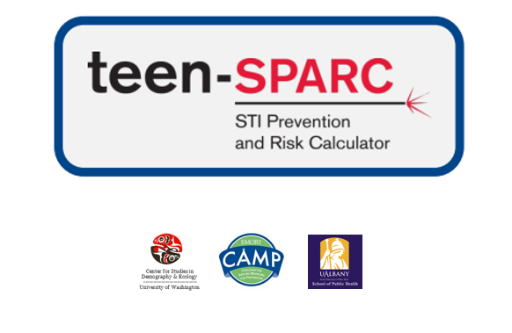
http://www.emorycamp.org/teensparc
CDC Webinar - June 7, 2019
Steven M. Goodreau and Emily D. Pollock
University of Washington
goodreau@uw.edu

Slide 2
The teen-SPARC team
University of Washington
Steven Goodreau
Emily Pollock
University at Albany – SUNY
Eli Rosenberg
Elizabeth Rosenthal
Meredith Barranco
Emory University
Monica Trigg
Megan Fields
Taylor Wimbly
Patrick Sullivan
CDC – DASH
Li Yan Wang
Richard Dunville
Lisa Barrios
CDC – NCHHSTP
Maria Aslam

Slide 3
Funding and disclaimers
This work was supported by the CDC/NCHHSTP Epidemiological and Economic Modeling Agreement (5U38PS004646).
The findings and conclusions are solely the responsibility of the authors and do not necessarily represent the official views of the Centers for Disease Control and Prevention or the Department of Health and Human Services.
Teen-SPARC requires Windows.

Slide 4
Webinar structure
  teen-SPARC overview
  tour of website
  example using national data
  example using local data
  Q&A

Slide 5
Teen-SPARC intro
Goals:
  Predict short-term impact of behavioral changes on STI burden among high-school attending adolescents in the US
  Help health departments “know their epidemic”
  Do so making maximal use of YRBS data available online
Structure:
  Publicly available Excel tool
  A set of national default parameters
  Documentation for the tool and parameters
  Files to simplify process of obtaining local/state parameters

Slide 6
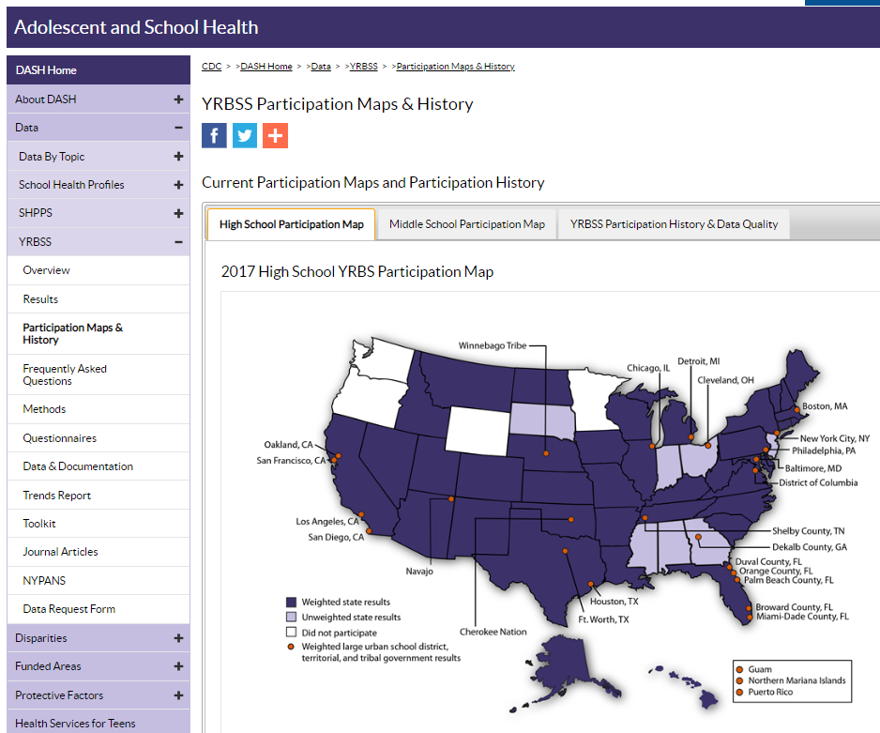
Audience
Expected user base:
  Staff in state and local health departments, especially (but not only!) in jurisdictions participating in YRBS
Notes:
YRBS is a complicated system in which most state HDs participate, as well as many major county and city HDs and some tribal HDs.

Slide 7
Dimensions
Three SPGs (sexual partnering groups):
        MSM (males who have sex with males)
        MSF (males who have sex with females only)
        FSM (females who have sex with males)
Three age groups
        13-15 year olds
        16-17 year olds
        18 year olds
Three infections:
    Gonorrhea
    Chlamydia
    HIV (MSM only)

Slide 8
Basic structure
Number of incident STI cases per year is a function of:
    # susceptible, sexually active individuals
    Mean # of sexual partners per person per year
    Mean # of sexual acts with those partners
    Level of condom use during those acts
    Prob. that partner has the STI in question
    Prob. that transmission happens given infected partner
Put together through a classic “Bernoulli” equation
Notes:
[No need to read each component – just summarize main point that it’s a short list of 5 things that seemed straightforward at the outset]

Slide 9
Deeper dive: partners per year
    Mean # of sexual partners per person per year
    Needed since the model has a one-year time horizon
    Inputs from YRBS are:
    Current age
    Year of first sexual intercourse
    Lifetime number of partners
    The tool takes care of all of the magic behind the scenes
Notes:
[No need to read each component – just summarize main point that it’s a short list of 5 things that seemed straightforward at the outset]

Slide 10
Full list of inputs per jurisdiction
Demographics
Size of school-attending population, by age and sex
Size of 13-18-year old population by age and sex
Sexual behavior
Proportion of students who have had sexual intercourse, by age and SPG
Mean number of new partners per year OR mean lifetime number of partners, by current age and age of first sex
Mean number of coital acts per partnership, by age and SPG
Probability of condom use by age and SPG
Clinical
Annual diagnoses by age, sex and SPG
Notes:
[No need to read each component – just summarize main point that it’s a short list of 5 things that seemed straightforward at the outset]

Slide 11
Standard inputs
Per-act transmission probability
Proportion of infections diagnosed
Mean duration of infection (for GC and CT)
Ratio of incidence to prevalence (for HIV)
Notes:
[No need to read each component – just summarize main point that it’s a short list of 5 things that seemed straightforward at the outset]

Slide 12
Baseline outputs
Number of new infections and diagnoses expected among high school-attending adolescents in the coming year, by age and SPG
Notes:
[No need to read each component – just summarize main point that it’s a short list of 5 things that seemed straightforward at the outset]

Slide 13
Behavioral changes
Users can explore changes in:
  Condom use
  Frequency of sex
  Either across the board, or broken down by:
  SPG (sexual partnering group)
  Age
  Output:
  Number and % of incident case averted (or added)
Notes:
[No need to read each component – just summarize main point that it’s a short list of 5 things that seemed straightforward at the outset]

Slide 14
Webinar structure
  teen-SPARC overview
  tour of website (http://www.emorycamp.org/teensparc)
  example using national data
  example using local data
  Q&A

Slide 15
Webinar structure
  teen-SPARC overview
  tour of website
  example using national data
  example using local data
  Q&A

Slide 16
Webinar structure
  teen-SPARC overview
  tour of website
  example using national data
  example using local data
  Q&A

Slide 17
Webinar structure
  teen-SPARC overview
  tour of website
  example using national data
  example using local data
  Q&A
      Please type in webinar app
      If we don’t get to your question today, check the manual at
      http://www.emorycamp.org/teensparc
      and/or email Steven Goodreau at: goodreau@uw.edu

Slide 18
The teen-SPARC team
University of Washington
Steven Goodreau
Emily Pollock
University at Albany – SUNY
Eli Rosenberg
Elizabeth Rosenthal
Meredith Barranco
Emory University
Monica Trigg
Megan Fields
Taylor Wimbly
Patrick Sullivan
CDC – DASH
Li Yan Wang
Richard Dunville
Lisa Barrios
CDC – NCHHSTP
Maria Aslam
Thank you!
      http://www.emorycamp.org/teensparc
      goodreau@uw.edu

